Slide 1
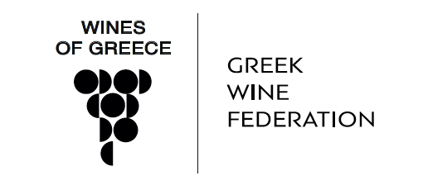
Viticulture

Slide 2
History
Long, thousands of years wine history and culture.
Famous ancient wines with designation of origin
Symposia: Intellectual gatherings where wine served as a social lubricant-always in moderation and diluted with water
Greek colonies spread out the art of making wine
Byzantine Empire – wines are exported to the Medieval Europe by Venetian traders. Wine highly connected to religion
Notes:
During classical times the Greeks had a well regulated wine trade. An early system of appellation of origin was established, to protect the value and guarantee the authenticity of high quality wines from specific areas. Much of the European Union's complex system of regulations governing wine production and labelling bear similarities to those in practice in ancient Greece. Wine laws referring to the island of Thassos have been found engraved in marble.

Slide 3
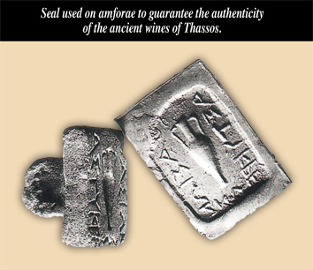
The first Appellation rules

Slide 4
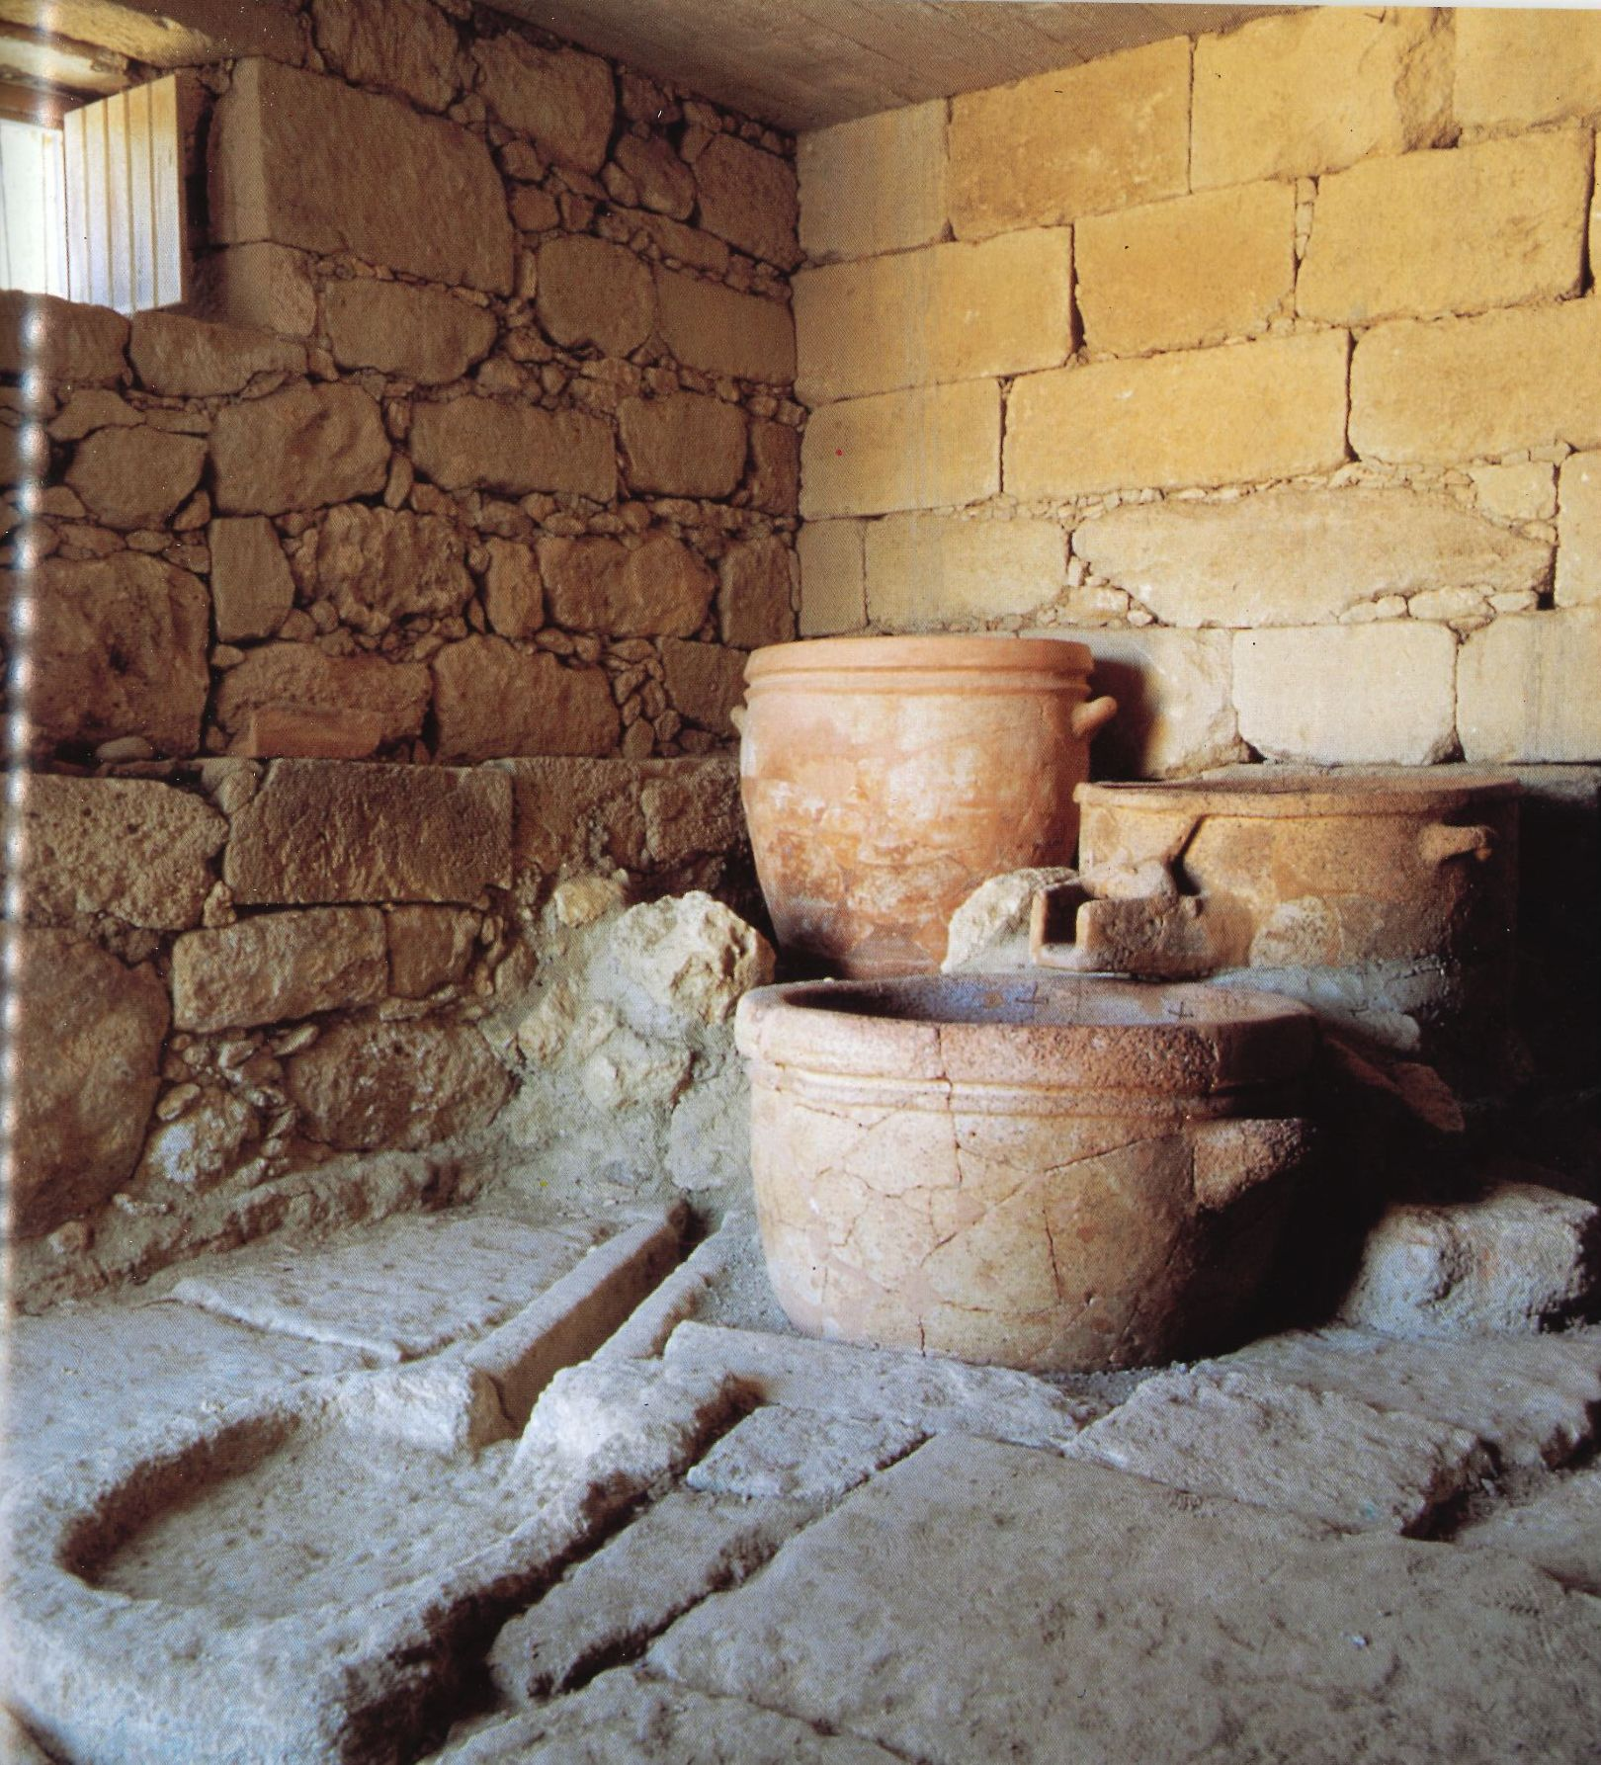
Notes:
From around 1600BC. Considered the oldest wine press found in Europe.

Slide 5
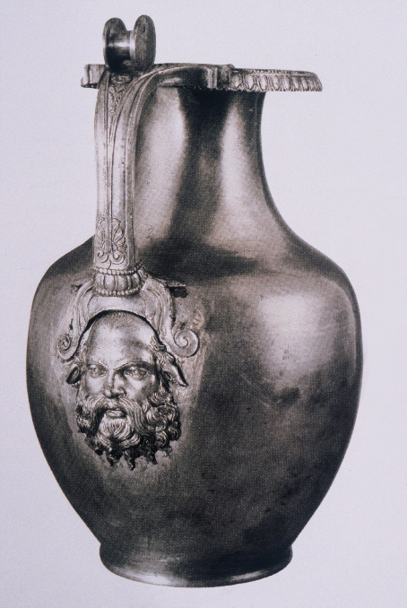
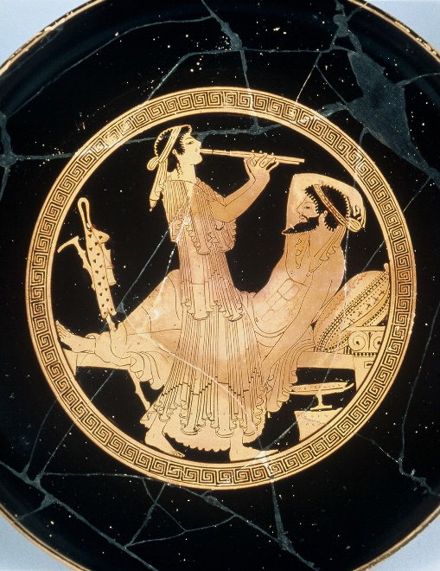
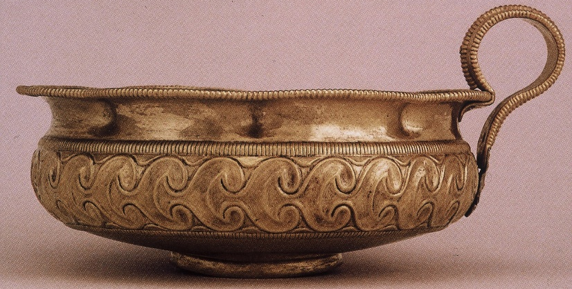
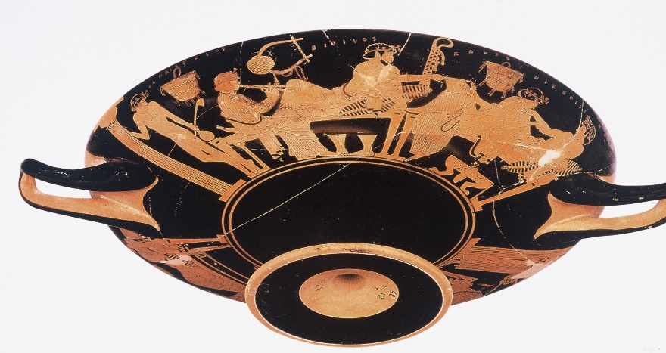
Greece: The first culture of wine
Notes:
They were not just drinking wine. They had the most sophisticated wine culture. Different drinking vessel for different occasions or wealth. The Riedels of the world.

Slide 6
Modern History
In the 19th century Greece fights for independence from the Turks. Greek state established in 1830.
Greece suffers from consecutive wars in the 20th century (Balkan, WWI & II, Civil
In the early 20th century phylloxera destroys most of the Greek vineyards
In the late 1960s and early 1970s the first official Greek wine legislation was created. The first Appellations are established
In 1980’s Greece enters the EU and investments in modern winemaking technology reaches the country

Slide 7
Modern History
Also in 1980’s the Oenology school at the Athens Technological college is established
1990’s Greek winemakers complete their studies in the top oenology schools of the world and return to Greece to introduce modern techniques. The Boutique wineries revolution is in full swing
Greek wines attract the attention of renowned international wine writers, critics and sommeliers.
Costumers seeking more authentic wines
Stand out in international wine competitions and wine shows.
Rising exports to important wine markets.

Slide 8
GREEK WINE AT A GLANCE
Τotal cultivated surface (2021 / 2022) : 64,900 Ha
Less than 0,8% of world wine production, less than 2% of EU wine
200.000 vineyard holdings, 160.000 families of vine growers
212 million litters (2022). Value 380 million euros
1600 Wineries, vast majority small family companies
300 and more indigenous grape varieties. 90% of vineyard
2/3 whites, 1/3 reds
33 PDO wines, 114 PGI Wines
15% of total wine production is exported
The main exporting country is Germany – 33 % of total exports
Export value: 100 million euros

Slide 9
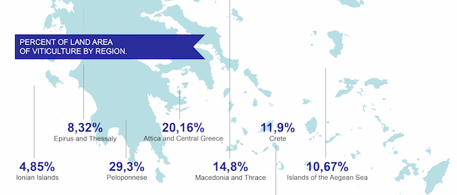
Greek vineyard area

Slide 10
Greek PDO-PGI wines

Slide 11
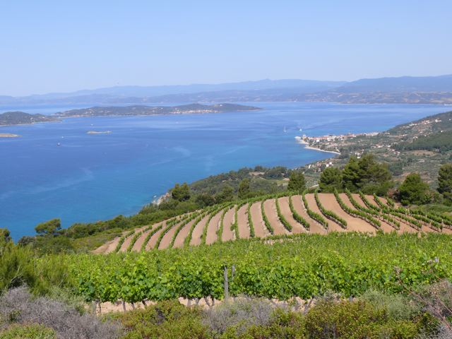
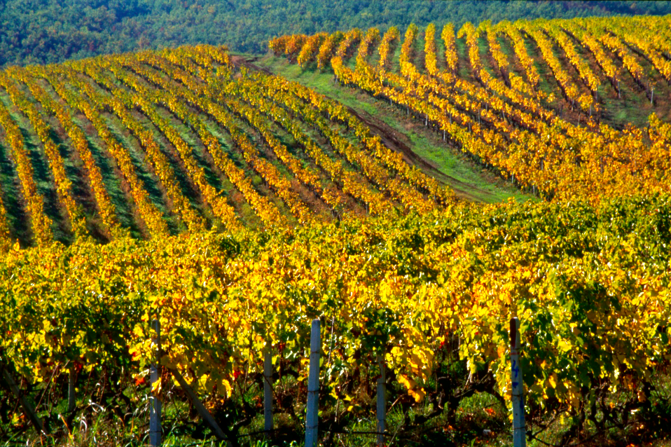
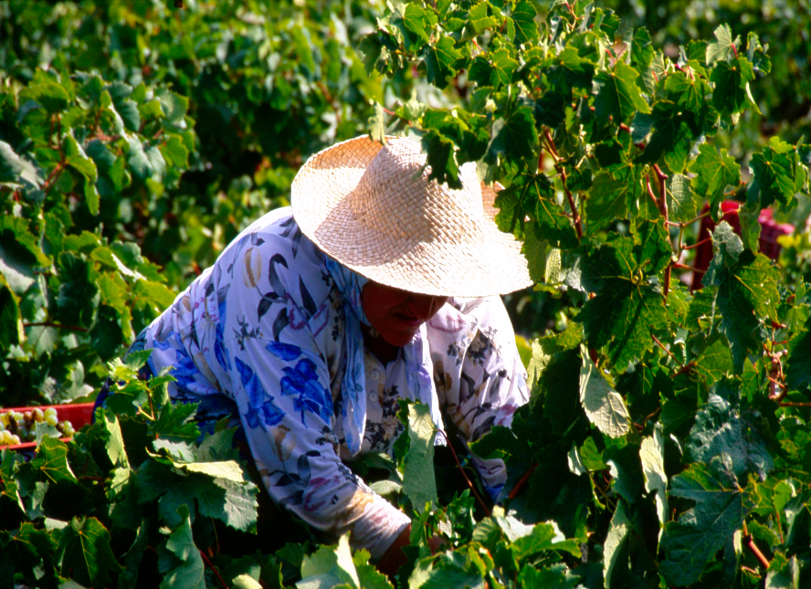
Greece: A land of contrasts
Notes:
Greece is the 3rd most mountainous country of Europe. At the same time where ever you are you are not more than an hour away from the sea.

Slide 12
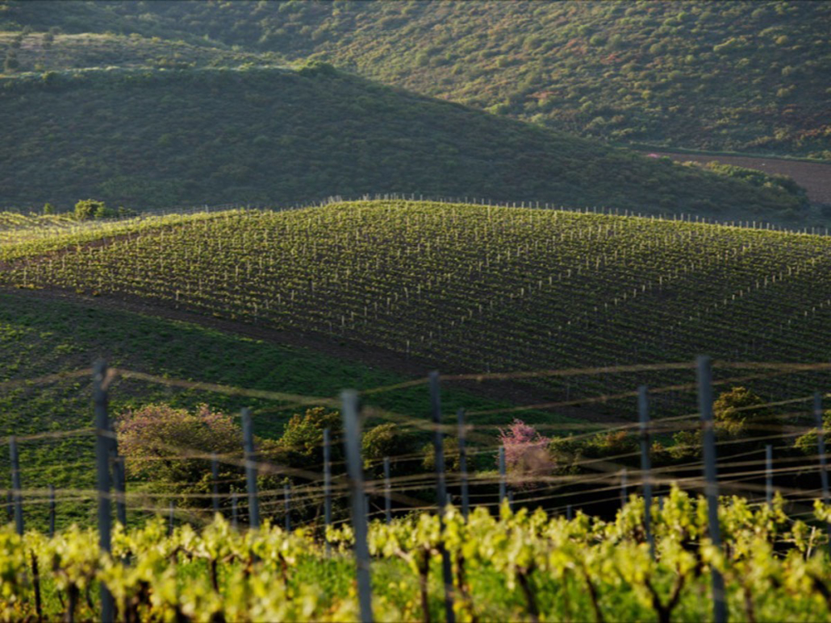
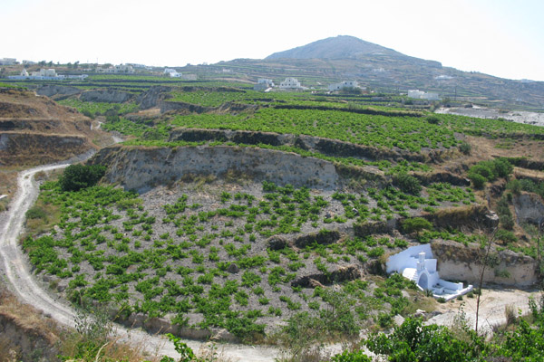
Notes:
Greece is at the same time one of the most ancient winemaking cultures and yet is considered one of the newer emerging winemaking countries in the market.
Thousands of years wine making tradition with many great stories to tell
First culture of wine in the world
Authenticity and Originality: 300+ indigenous grapes, amazing microclimates
Boutique style winemaking: Valuable and rare finds
Wine tourism amongst many breathtaking winemaking regions

Slide 13
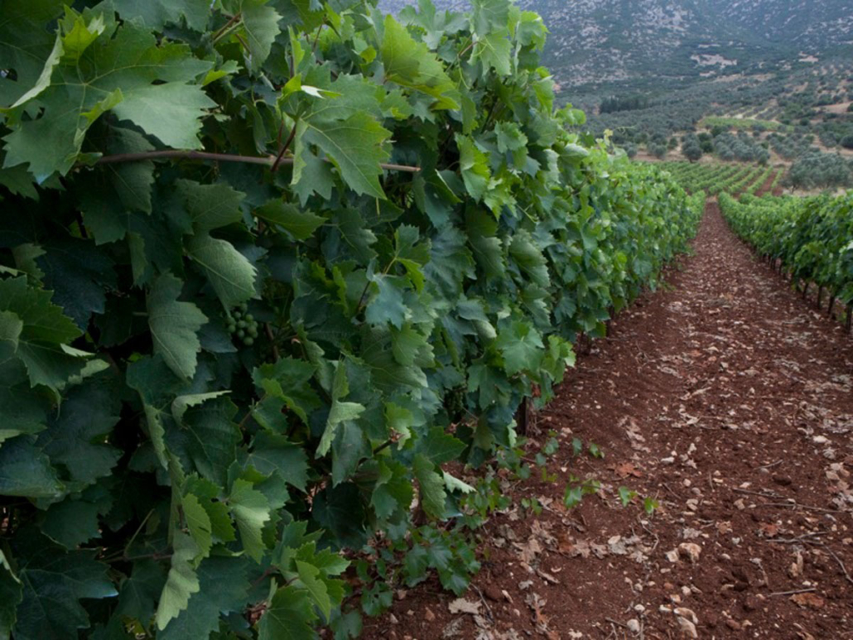
Notes:
Dramatically diverse landscape
Food friendly wines
Great value especially, for medium and premium categories
Talented, educated winemakers

Slide 14
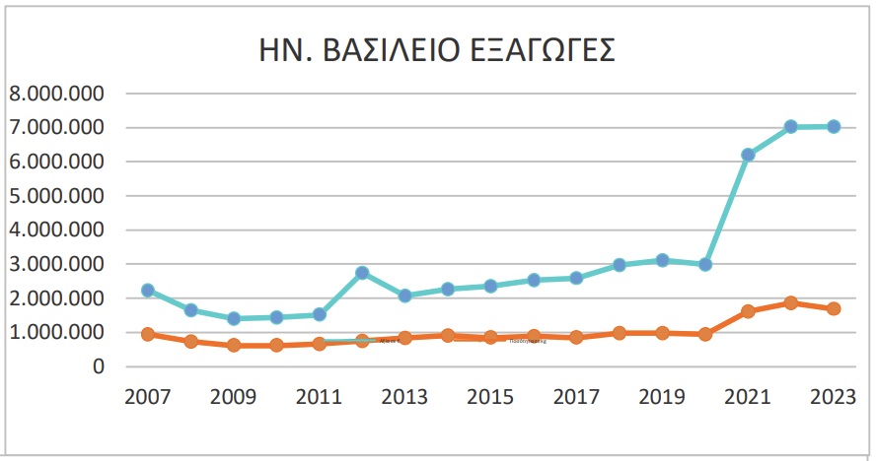
Greek wine exports to the UK
Exports to the UK
Value in €
Quantity in kg
Price/Quantity € / kg
2018 | 2019 | 2020 | 2021 | 2022 | 2023 | % | 5 Years Average
2.966.807 | 3.116.931 | 2.993.638 | 6.197.261 | 7.012.441 | 7.017.702 | 0,08 | 4.457.416
974.917 | 975.875 | 939.520 | 1.616.371 | 1.857.776 | 1.690.213 | -9,02 | 1.272.892
3,04 | 3,19 | 3,19 | 3,83 | 3,77 | 4,15 | 10,00 | 3,00
%
57,441
32,79
21,89

Slide 15
1. JIMAS SUPER GIRL WHITE 2022
Grape | Debina
Denomination | Varietal wine
Vintage | 2022
Soil | Red clay with stones
Altitude | 350 m
Vineyard age | 40 years
Viticulture | Sustainable
Vinification | White wine vinification. Unfiltered
Alcohol % | 12%
pH: | 3.3
Total production | 2000 btls

Slide 16
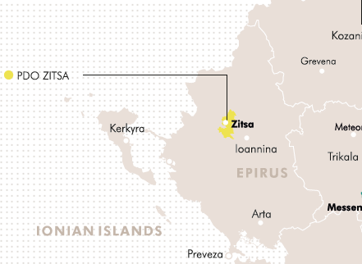
Epirus
Highly mountainous (Pindos)
High altitude 700m (2300 ft.)
Humid and cool climate
High Rainfall
Ionian Sea moderates extreme weather
Clay of a medium lime content soil
Main regions: Ioannina (PDO Zitsa) & Metsovo (PGI)
Notes:
Expressive wines from local varieties in Zitsa
Epirus’s natural beauty and cultural heritage as well as its many areas whose climate is barely suitable for viticulture can be its trump card in showcasing and promoting a small – but enterprising – regional wine industry
Poor soil on the slopes / richer soils in plains

Slide 17
Epirus
PDO Zitsa
Debina (sensitive to fungal infections and drought)
White wines
Best from low-yielding vineyards
Dry, medium-dry, medium-sweet, sparkling and semi-sparkling
Medium aromas intensity, green apple, citrus, low alcohol, light body
Notes:
Low alcohol content, rarely exceeding 11.5 percent, with high acidity

Slide 18
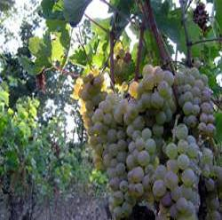
Debina
High yields
Sensitive to drought and many diseases
Late ripeness
Green apple, white peach, flowers
Medium to high acidity
Low alcohol level
PDO Zitsa (still, semi sparkling, sparkling)
Notes:
Colour: light intensity
Acidity: medium to high
Bottle Ageing: preferably consumed while it is young
Wine style: light, refreshing with a lemony finish

Slide 19
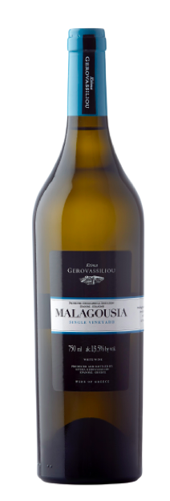
2. GEROVASSILIOU MALAGOUSIA 2023 - MACEDONIA
Grape | Malagousia
Denomination | PGI Epanomi
Vintage | 2023
Soil | mainly sandy with a few clayey substrates and calcareous rocks
Altitude | 110-120 m & 7-15% inclimation
Vineyard age | 30 years old
Viticulture | Sustainable
Vinification | Following skin contact in cold, vinification is carried out in stainless steel tanks at 18 °C, while some is vinified in French oak barrels. The wine is left with its lees for a number of months to gain structure and body.
Alcohol % | 13,5%
pH 3.28 | Acidity: 5,99 g/l

Slide 20
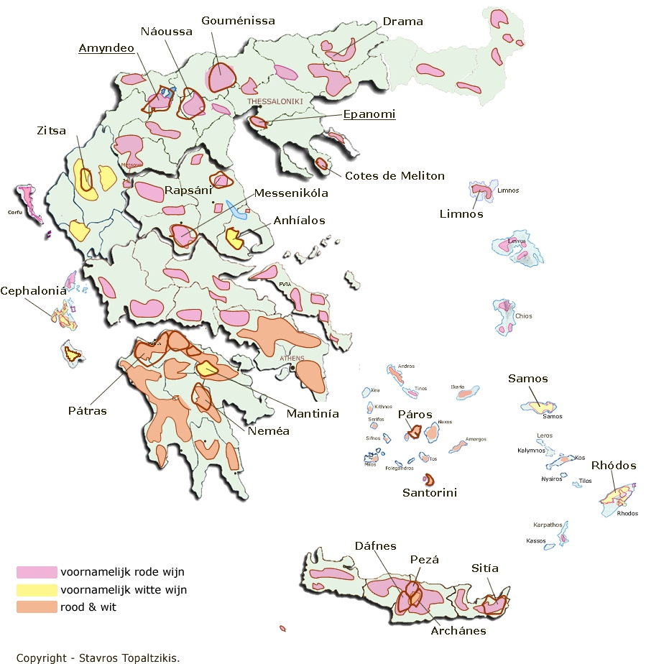
CENTRAL MACEDONIA
Mantinía
Red wines
White wines
Red and White wines

Slide 21
MALAGOUSIA
Grows vigorously
High yields
Susceptible to diseases
Resistant to drought
Medium acidity
High alcohol
Aging potential
Affinity to oak
The ripeness level defines the aromatic profile
High level of ripeness
Peach, citrus, ripe tropical, green pepper
Low level of Ripeness
Vegetal, botanical aromas, mint, tea

Slide 22
3. PAVLIDIS EMPHASIS ASSYRTIKO 2023
Grape | Assyrtiko
Denomination | PGI Drama
Vintage | 2023
Soil | Marly Limestone
Altitude | 400-500 meters
Vineyard age | 19 years
Viticulture | Sustainable. Training system Double Guyot
Vinification | White wine vinification in inox and oak tanks. Maturation 6 months in Inox and amphora.
Alcohol % Sugar | 13.9%
pH: 3.23 | Acidity: 4.72 g/lt
Total production | 15.000 bottles

Slide 23
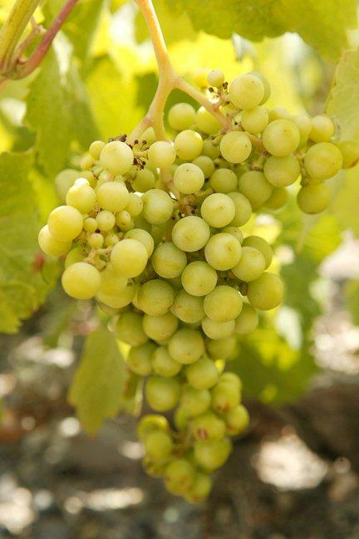
ASSYRTIKO
One of the noblest white varieties of the world
High adaptability
Resistant to most diseases
High levels of acidity
Not particularly high aroma intensity
Purity
Medium to full body
High alcohol
Long ageing potential
Best offer for climate change
Notes:
Its vigour is medium to high and under suitable conditions it can produce high yields

Slide 24
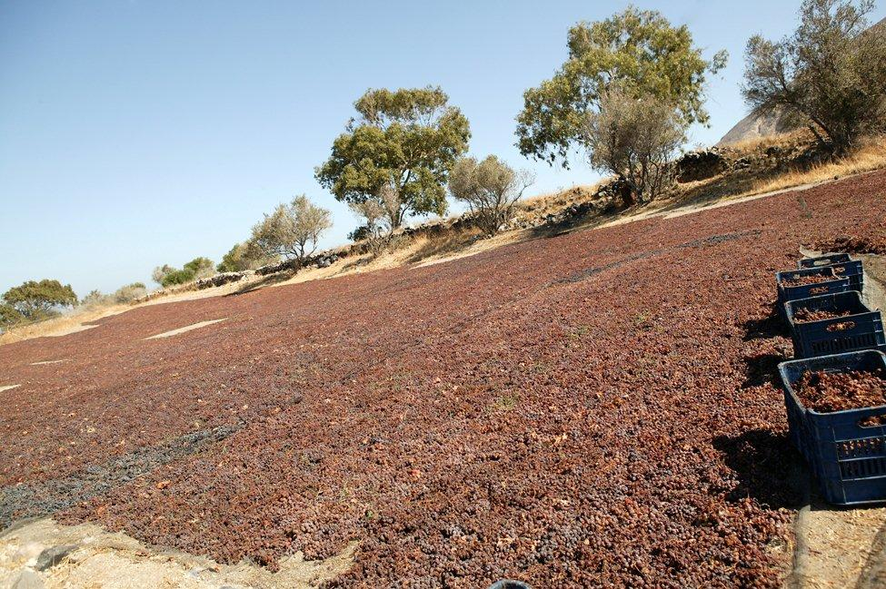
Assyrtiko
Green apple & white peach
Crushed seashells and stone
Minerality
When fermented or aged
in barrels:
Ripe stone fruits
Honey & wax
Petrol & flint
Notes:
Colour: medium intensity
Acidity: high
Aromas: not of high intensity but highly individual
Green apple, peach, crushed seashells and minerals
Maturity in bottle: honey, kerosene - high ageing potential
Unoaked Style: austere, dry, mineral
Oaked Style: rich, full, complex

Slide 25
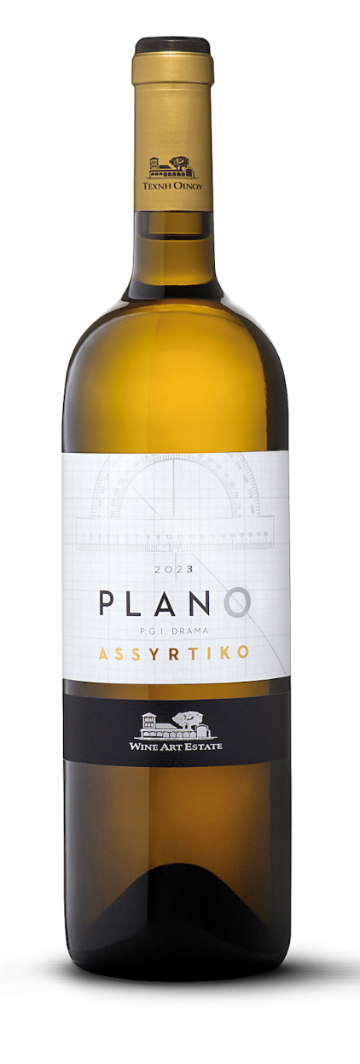
4. WINE ART PLANO ASSYRTIKO 2023
Grape | Assyrtiko
Denomination | PGI Drama
Vintage | 2023
Soil | Sandy-Clay over limestone layers.
Climate | Continental with intense temperature changes of day and night, northern cool winds during summer.
Vineyard age
Viticulture | Under conversion to organic viticulture
Vinification | Cold soaking of the skins prior to fermentation to transfer aroma components from the grapes to the must. Fermentation in stainless steel tanks with battonnage sur lies to provide volume and complexity.
Alcohol % | 13.1%
pH: 3.09 | 5.8l/gr
Total production | 12.000 btls

Slide 26
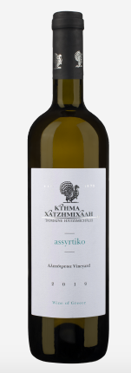
5. HATZIMICHALIS ALEPOTRYPA ASSYRTIKO 2023
Grape11 | Assyrtiko
Denomination | PGI Atalanti valley
Soil | Clay & Loam
Viticulture | From the selected single vineyard "Alepotrypa" part of the privately owned vineyards of Domaine Hatzimichalis in the heart of the Atalanti Valley. Located close to the sea in flatland.
Vinification | White vinification in temperature-controlled stainless steel vats. The wine remains in the vats with its lees for 6 months.
Alcohol % | 14.5
pH: | Acidity:
Total production | 25.000

Slide 27
6. BIBLIA CHORA ARETI 2022
Grape | Assyrtiko
Denomination | PGI Pangeon
Vintage | 2022
Soil | Calcareous and loamy
Altitude
Vineyard age
Viticulture | Organic
Vinification | Once the grapes are crushed, the juice is fermented in stainless steel tanks and allowed to rest on fine lees for several months.
Alcohol % | 13.5
pH: 3.09 | Acidity: 7.65 g/lt
Total production

Slide 28
7. CHATEAU NICO LAZARIDI EVIL EYE 2022
Grape | Xinomavro
Denomination | PGI Macedonia
Soil | Light, sandy
Location | Amyndeo-Agios Panteleimonas
Altitude | 550 m
Vineyard age | 50+ years
Viticulture | Conventional
Vinification | Rosé vinification begins with the early harvest of Xinomavro. Direct pressing of the grapes to minimize the color extraction to achieve the desired pale pink color. Fermentation takes place under controlled, low temperatures to maximize the floral and fruity notes. It matures in stainless steel tanks for 5 months over lees.
Alcohol % | 12
pH: 3 | Acidity: 6.9 g/lt
Total production | 15.000

Slide 29
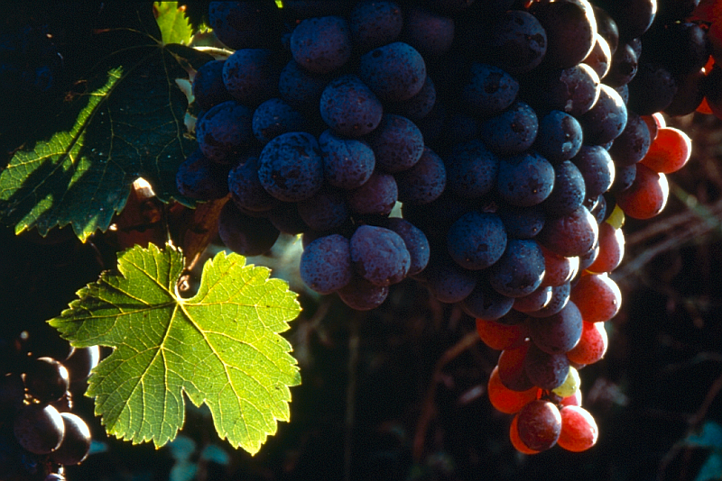
Xinomavro
Sensitive to diseases and draught
Difficult cultivation
Late ripening variety
Difficult vinification
Versatile: still, sparkling, semi-dry, Blanc de Noir, rose
© Wines of Greece
Notes:
Noblest red variety of northern Greece
Often compared to the Italian Nebbiolo or the French Pinot Noir
Quality of Xinomavro is compromised by high yields
High level of dry tannins and high acidity makes ageing and maturing in oak barrels almost obligatory

Slide 30
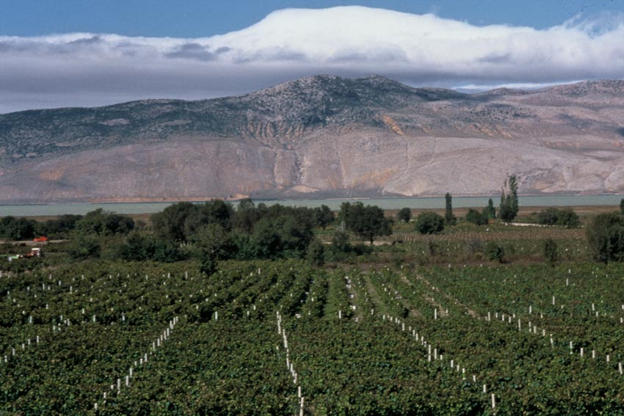
Xinomavro
Red small fruits, sour cherry, olive, tomato
High acidity and high level
of dry tannins
PDO Amydeo
PDO Naoussa
PDO Goumenissa
PDO Rapsani
Blends with Negoska, Stavroto, Krasato, Merlot, Syrah
© Wines of Greece
Notes:
Colour: medium
Acidity: high
Tannins: high, austere
Aromas: red wild berries, morello cherry, black olive,
tomato, cabbage
Bottle ageing: develops slowly, high ageing potential, mushroom, tobacco leaves
Wine style: austere, tannic, elegant, powerful
Great ageing potential
PDO NAOUSSA: Xinomavro
PDO AMYDEO: Xinomavro
PDO GOUMENISSA: Xinomavro, Negoska
PDO RAPSANI: Xinomavro, Krassato, Stavroto

Slide 31
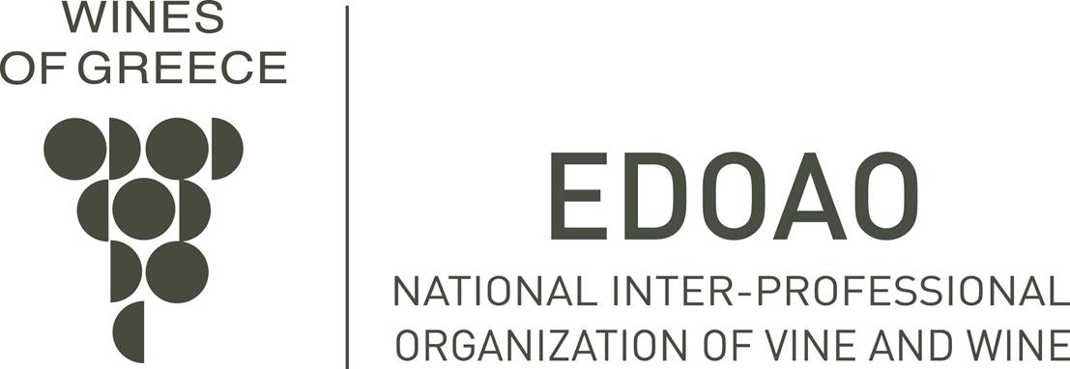
Xinomavro
Traditional vs modern
Traditional:
Pale color
Tomato, cabbage, black olive, red fruits
High level of firm tannins
Modern:
Deepest color
More fruity aromas
Less harsh tannins
© Wines of Greece
Notes:
Key factor in this style is cold-soak before the alcoholic fermentation

Slide 32
8. DOMAINE LAZARIDI CHATEAU JULIA AGIORGITIKO 2021
Grape | Agiorgitiko
Denomination | PGI Drama
Vintage | 2021
Soil | Alkalic clay with a lot of coarse elements
Altitude | 200-300m northern exposure
Vineyard age | Kali Vrisi, 28 years old vineyard
Viticulture
Vinification | Harvest by hand, double selection upon arrival at the winery, de-stemming, crushing, fermentation in stainless steel tanks, malolactic fermentation and ageing in 500lt barrels (50%), cask (25%) and concrete tank (25%) for 12 months.
Alcohol % | 14.2%
pH: 3.7 | Acidity: 5.25 g/l
Total production

Slide 33
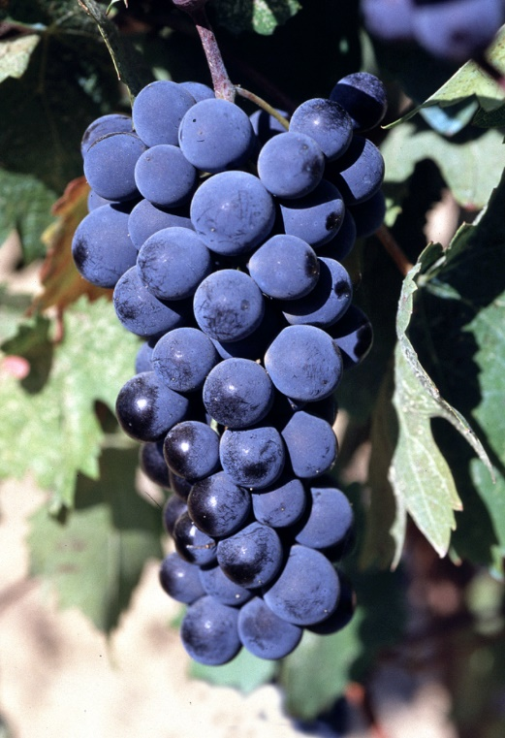
AGIORGITIKO
Productive variety
Sensitive to diseases and draught
Late ripening
Versatile
Rose, light reds, medium bodied, rich tannic with ageing potential wines
Peloponnese
© Wines of Greece
Notes:
Considered the most commercial and the most widely recognised Greek red variety on the international market
Can be particularly high-yielding

Slide 34
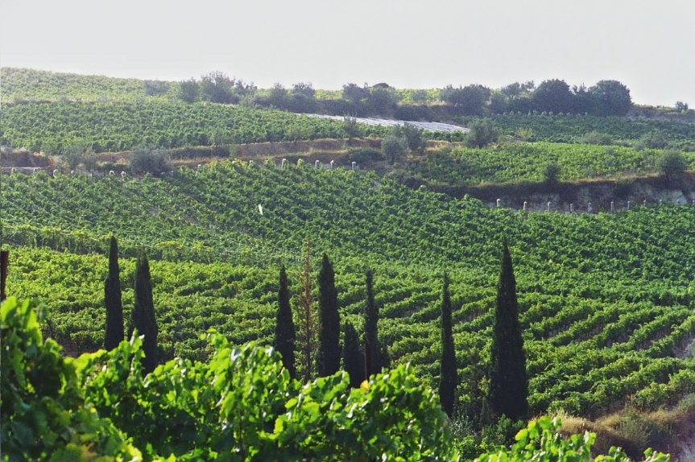
AGIORGITIKO
Deep color
Sweet red fruits, sweet spices, chocolate
Medium to high acidity
PDO Nemea
Often blended with Cabernet Sauvignon
© Wines of Greece
Notes:
Colour: deep
Acidity: high
Tannins: medium-soft
Aromas: red fruits, cherry, raspberry, sweet spices,
coffee, chocolate
Bottle ageing: develops fast, coffee, chocolate
Wine style: fruity, dense, rich

Slide 35
9. SAMARTZIS MOUHTARO 2021
Grape | Mouhtaro
Denomination | PGI Theva
Vintage | 2021
Soil | Sandy clay, gravel
Altitude | 420 m
Vineyard age | 7 years
Viticulture | Sustainable. Training system: Royat
Vinification | The handpicked grapes are carefully destemmed and placed in open-top 500-liter barrels. The cap is broken only by pushing gently the grape mass into the must/wine by hand, without the use of any tool or pump. The fermentation and extraction process takes approximately +/- 25 days. Following the end of fermentation stage /skin contact period the grapes undergo a gentle pressing using a vertical basket press to extract around 3% of press wine. The wine matures in large volume barrels (10% new, second/third use) for a period of 12 months before being bottled-unfiltered.
Alcohol % | 14.5
pH: 3.25 | Acidity: 6.95 g/lt
Total production | 4000 750ml bottles, 200 Magnums

Slide 36
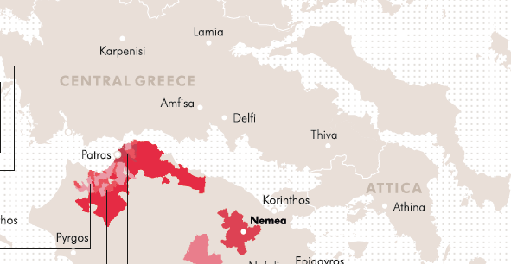
Central Greece
Part of the Pindos Mountain Range
Wide diversity of soils / from very poor to very fertile
Complex topography
Attiki
Evia
Viotia
Fthiotida

Slide 37
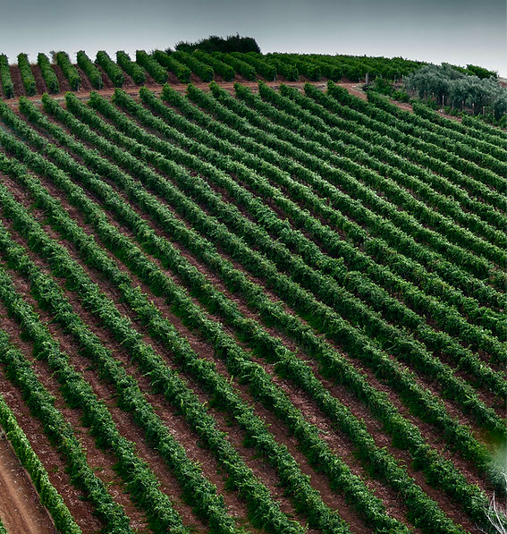
Muses valley
North-west of Athens, in the region of Viotia
On the slopes of Mount Helicon
Climate: mild, with wet winters and dry summers. Long periods of sunshine
Altitude between 450 and 520 m with a slope between 5 and 10%.
Linear vines with a North to South orientation
Cold air currents coming down from Mount Helicon
The soil is fertile, with mixed composition ranging from sandy loam to clay loam.
More than 50 hectares of cultivated vineyards
​

Slide 38
MOUHTARO
Rare, up and coming variety Color: Dark black red. Aromas: Sour cherry, blueberries, herbal notes of mint, floral notes of violet and lavender. Acidity: Crisp Taste: Rich, creamy, layered, and dense with long aftertaste. Body: Full-bodied

Slide 39
10. ALPHA ESTATE ECOSYSTEM OLD VINES XINOMAVRO 2020
Grape | XINOMAVRO
Denomination | PDO Amyndeo
Vintage | 2020
Soil | Sandy - sandy clay soil of excellent drainage.
Altitude | 647 m
Vineyard age | Sandy - sandy clay soil of excellent drainage.
Viticulture | Over 90 years old, 100% ungrafted bush vines (Gobelet). Climate: Semi continental with satisfactory rainfalls, significant snowfalls and warm, dry summer with fresh nights. Frequent north-west winds, absent of spring frost.
Vinification | Destemming, light crushing, cold soak - skin contact, alcoholic fermentation by indigenous flora isolated from the specific block, at gradual increasing temperatures, maintenance of wine “sur lies” for 18 months with regular stirring. Ageing: 24 months in new Allier - Bertrange French oak casks medium grain, white toast and 12 months in the bottle before release
Alcohol % | 14.2%
pH: 3.39 | Acidity: 6.41 g/lt

Slide 40
11. NOEMA INVICTA 2020
Grape | Xinomavro
Denomination | PDO Amyndeo
Vintage | 2020
Soil | Sandy
Altitude | 690m
Vineyard age | 10 years old
Viticulture | Conventional
Vinification | The grapes are strictly hand-harvested to remain intact. Then, transferred to the winery in a refrigerated truck and chilled to below 10ºC before they enter the pneumatic press. There, after being destemmed, they are left to cold soak for 4days at 10ºC in order to maximize the gentle extraction of color and aromas from the grapes. Fermentation lasts for 2 weeks at temperatures not exceeding 26ºC, while pumping over is used for color extraction. Malolactic fermentation takes place in the tanks before the wine is transferred to oak barrels, where it will mature for 6 months in 300 lt medium grain and white toasting French oak. The wine will age in the bottle for 12 months before being released into the market.
Alcohol | 12%
pH: 3.34 | 6 g/lt
Total production | 12.000

Slide 41
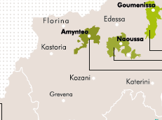
Western Macedonia
Higher rainfall from the rest of Macedonia
Hail and snow
Continental climate
Mountainous (part of the Pindos Range)
Diversity of soils
Florina is the coldest viticultural area of Greece
Xinomavro, Moschomavro the main varieties
Notes:
Florina, Kastoria, Grevena and Kozani
Most of this can easily be classified as cool climate

Slide 42
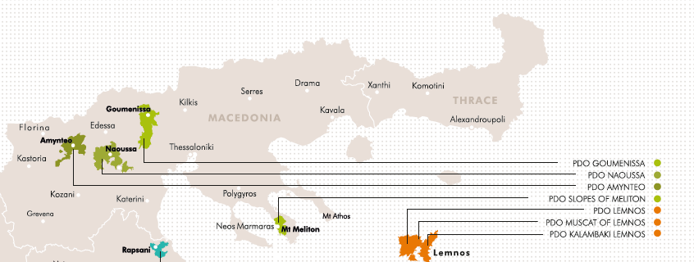
PDO Wines

Slide 43
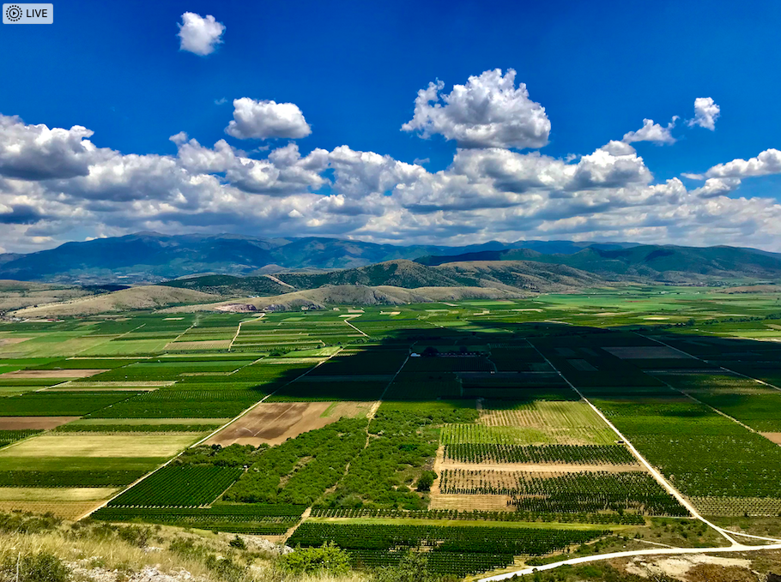
PDO Amydeon (Amynteo/Amyntaio)
PDO Amydeon (Amynteo/Amyntaio)
Cool climate
High altitude (750 m-2460 ft.)
Vegoritis and Petron lakes
Best soils are the sandy

Slide 44
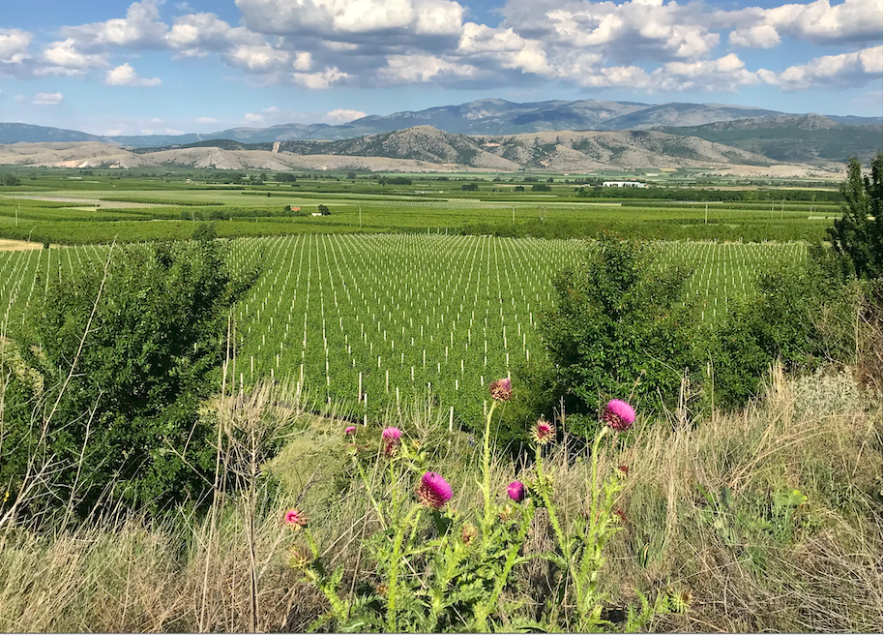
PDO Amydeon
Xinomavro only
Dry Red, dry roses and sparkling roses (dry, medium dry)
Reds: lighter style than Naoussa, less tannic, more floral
Close tank method or traditional for sparkling
Notes:
Some modern Amydeon Xinomavros can be a lot more powerful than any Naoussa, but this is down to the producers’ style

Slide 45
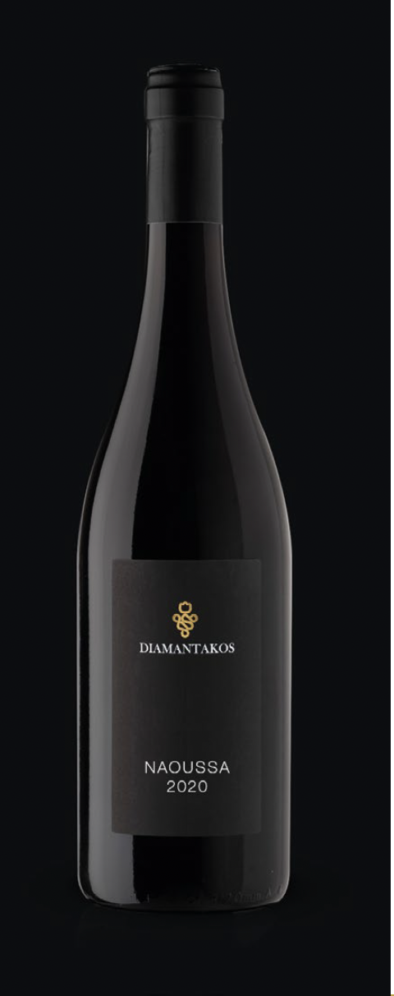
12. DIAMANTAKOS NAOUSSA 2020
Grape | Xinomavro
Denomination | PDO Naoussa
Vintage | 2020
Soil | Gravely sandy clay
Altitude | 200-240m
Vineyard age | 40 years
Viticulture | Double spur cordon
Vinification | 3 days pre-fermentation cold soak at 10ºC. Fermentation into open top stainless steel vats for 2 weeks at 28ºC. Gently pump overs initially gently and finishing with punch down. Malo in stainless steel & barrels. Aging 10-11 months in French oak, medium long toasting 500 lt, 20% new. Racking the fine lees after first 4 months and toping up once per week
Alcohol % | 13.8%
pH | 3.43
Total production | 835 κιβώτια

Slide 46
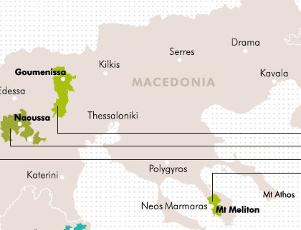
Central Macedonia
Kilkis, Thessaloniki, Chalkidiki, Edessa, Veroia, Pella
Moderate climate
Sea effects on vineyards close to coastal
Lower altitudes
Notes:
there are no high mountains like in Western Macedonia

Slide 47
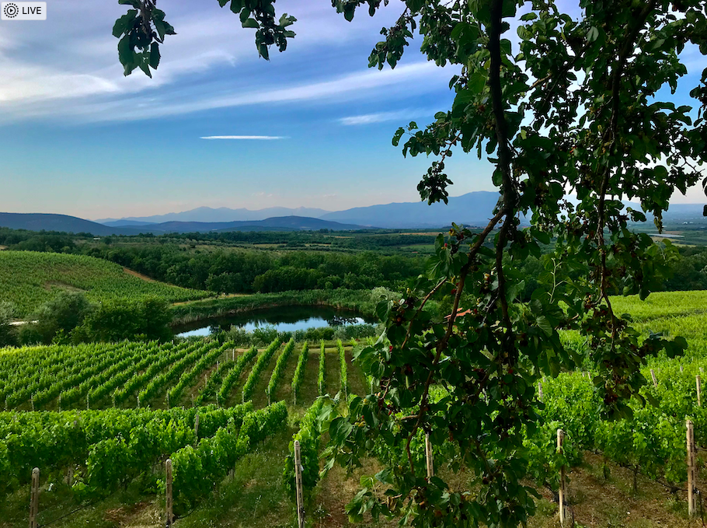
PDO Naoussa
50 to 450m (165-1480 ft.)
Southeast of Mt. Vermion
Semi continental and warmer than Amydeon
Frosts during spring
Diversity of soils from limestone to clay loamy and sandy soils
Notes:
Many people talk about the crus of Naoussa but this is debatable

Slide 48
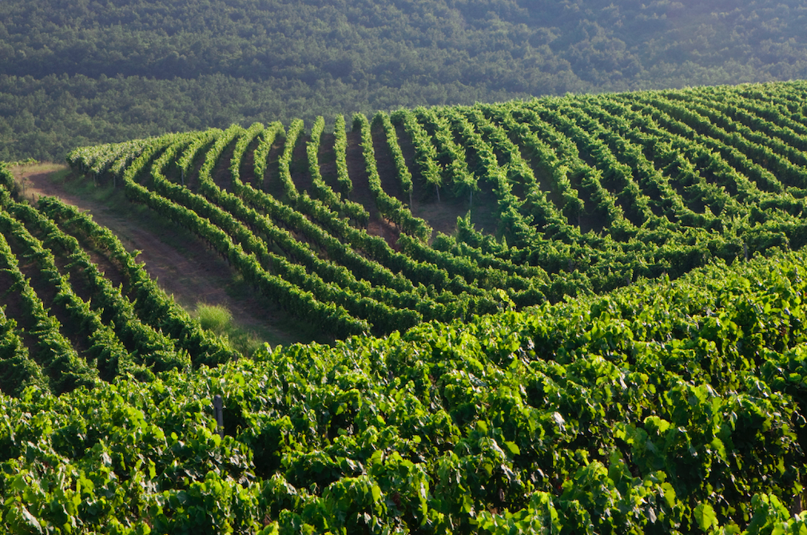
PDO Naoussa
Xinomavro 100%
Max yields: 70hl/ha
Vintage variation
Harvest late September – Late October
Notes:
Xinomavro marries with international varieties, such as Μerlot, Syrah or Cabernet Sauvignon in PGI wines

Slide 49
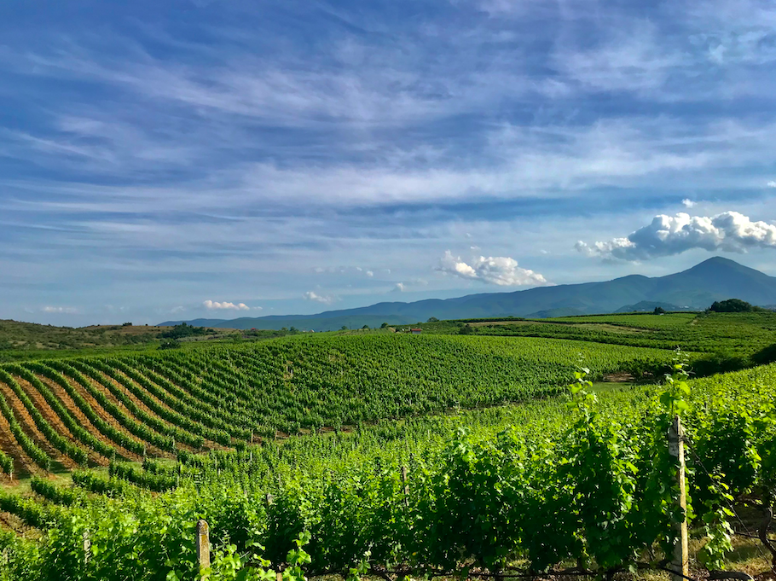
Traditional vs modern Naoussa
Traditional:
Pale color
Tomato, black olive, red fruits, leather, spices
High level of firm tannins, high acidity, medium body
Modern:
Deepest color, higher extract
More fruity aromas
Less harsh tannins, less acidity, fuller body

Slide 50
13. KIR YIANNI RAMNISTA 2019
Grape | Xinomavro
Denomination | PDO Naoussa
Vintage | 2019 was considered a great vintage. The cold winter, the notably rainy spring and the long dry summer days were followed by 2 months (August and September) with ideal mild conditions and significant temperature difference between day and night.
Soil | We use grapes mostly from the vineyard blocks of lower pH and with lighter soil type in order to maximize the aromatic intensity and complexity.
Altitude | 120-280m
Vineyard age | 50+ years
Viticulture | Sustainable
Vinification | Rigorous grape selection on conveyor belt. Cold soaking for 7 days at low temperatures (8-10°C). Fermentation with pigeage for 10-15 days and pump-overs in a combination of French oak vats (5 tons) and stainless-steel tank (5 tons) at a temperature of 20-26°C that is preserved during the post-fermentation maceration (2-6 days). Malolactic fermentation in French oak barrels. Maturation for 16 months in French oak (228 lt) of 1st, 2nd and 3rd use. The first blend of the blocks is made in the 6th month of maturation.
Alcohol % | 14
pH: 3.42 | Acidity: 5.5g/lt
Total production

Slide 51
14. BOUTARI GRANDE RESERVE 2013 - MACEDONIA
GrapeE No 11 | Xinomavro
Denomination | PDO Naoussa
Vintage | 2013
Soil | Varied types from acid schishtone to high in limestone and clay
Vineyard age | 30-50 years old
Viticulture | Individually selected plots of the Trilofos area, harvested and vinified separately.
Vinification | After the end of aging in the barrels, final master blend is made from these individual batches. Fermentation in stainless steel tanks at 22-27°C (with cold maceration) and the juice remains in contact with the marc for 7-15 days. Controlled malolactic fermentation. Aged for two years minimum in French oak barrels(225 and 400 lt), stays in bottle for another two years in the winery cellar.
Alcohol % | 12.7
pH: 3.58 | Acidity: 5.8
Total production

Slide 52
15. KECHRIS TEAR OF THE PINE 2022 - MACEDONIA
Grape | Assyrtiko
Denomination | Retsina Appellation by Tradition
Vintage | 2022
Soil | Clay loam with medium composition
Altitude | 270-300m
Vineyard age | 12-15 years old
Viticulture | Sustainable viticulture
Vinification | Alcoholic fermentation in new oak barrels of various types from different regions and maturation for 6 months on fine lees.
Alcohol % | 13.5
pH: 3.1 | Acidity: 6.8g/l
Total production | 50.000 btls

Slide 53
RETSINA
In antiquity pine resin added as a natural antioxidant
Amphorae were sealed with Pine resin as a natural preservative to protect the wines during long voyages.
Resin also added a flavoring to the wine and people became accustomed to. ►The first Retsinas were created.
Retsina popular in the 1960s when Greece emerged as a global tourist destination.
Retsina, connected with the Greek summer, taverns by the sea, the warm sun and fresh seafood

Slide 54
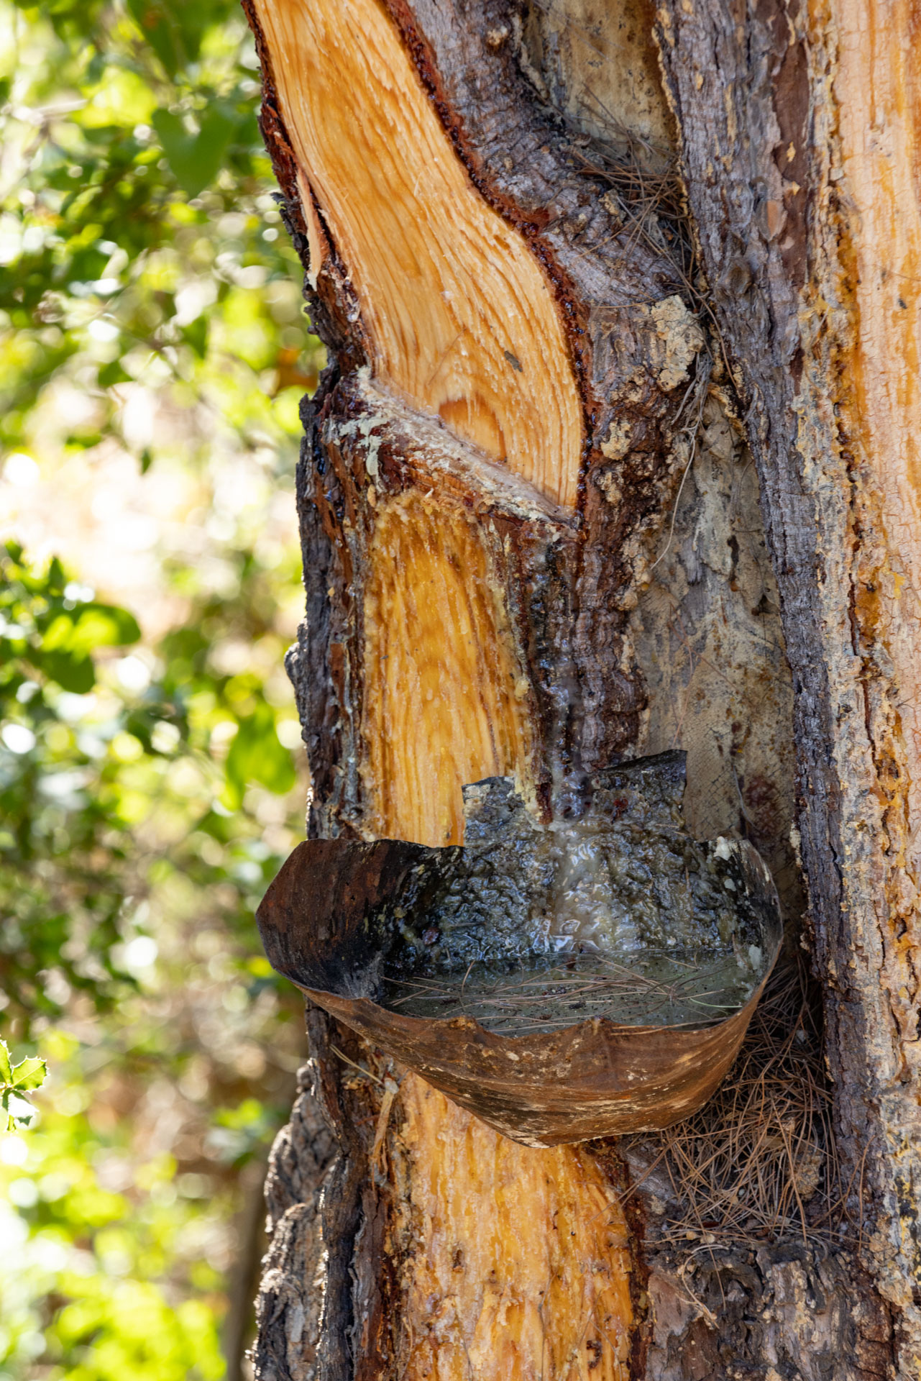
RETSINA
Retsina was the most recognizable wines Greece, but this did not mean quality
Always the cheapest wine on the table, usually made from inferior wine.
The name Retsina became associated with cheap, poor quality wines.
Usual practice at the time was:
use large doses of resin to mask poor quality grapes
often by untrained, amateur winemakers without advanced technical means.
Wines turned out to be oxidized, flabby, without any freshness and lacking in balance. The over use of resin also destroyed any hint of the grape.

Slide 55
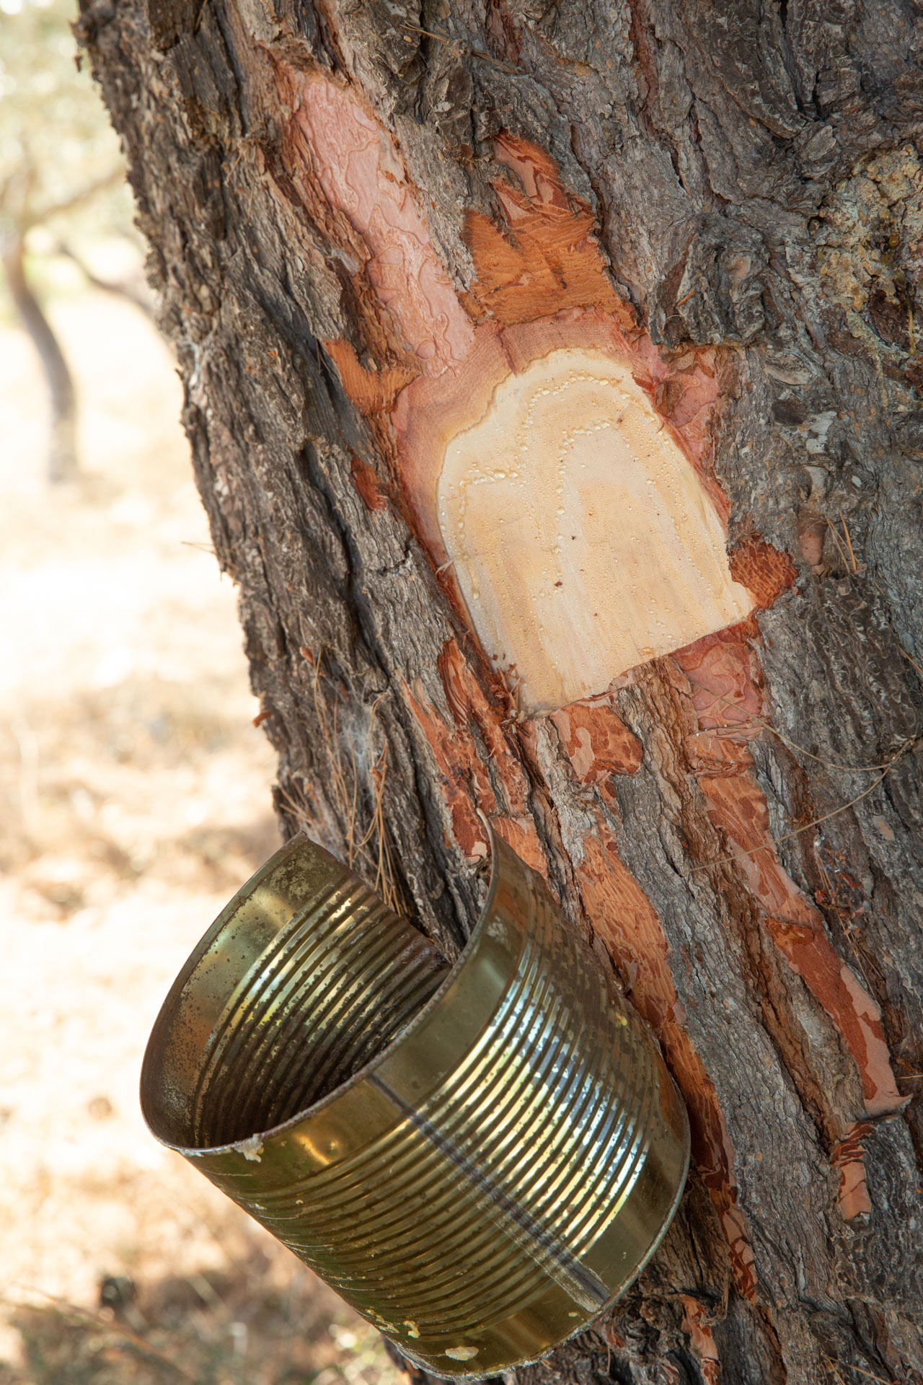
TODAY’S RETSINA
Top grape quality
State of the art winemaking technology, use of modern amphorae and oak barrel aging.
Aleppo pine resin (PINUS HALEPENSIS) added before the start of the alcoholic fermentation (or during as long as no amount of sugar greater than 1/3 of the original content has been fermented), in an amount of up to 1 kilogram per 100 liters of must.
Often producers use a significantly lower percentage of pine resin.
In addition to the amount of resin, the amount of time the resin is with the must is carefully controlled, as well as the temperature at which the extraction takes place.
Modern Retsinas show elegant aromas of pine, sage, rosemary, mastic, ginger and spicy spices accompany the dense fruit
The best Retsinas now show aging potential

