Slide 1
Masterclass: Madeira Wine – Tradition in Sync with Innovation Presented by Demetri Walters MW

Slide 2
While often served as an aperitif or a dessert, Madeira wines are a perfect modifying ingredient in cocktails.
We will demonstrate how Madeira’s well-rounded flavor profile, and balanced level of sweetness and acidity, can enhance a range of cocktails.
Madeira and Cocktails

Slide 3

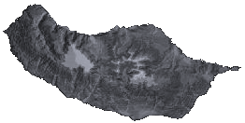
900 km from Lisbon / Portugal
700 km from African Coast
Total area: 741Km²
Madeira Wine _ Location

Slide 4
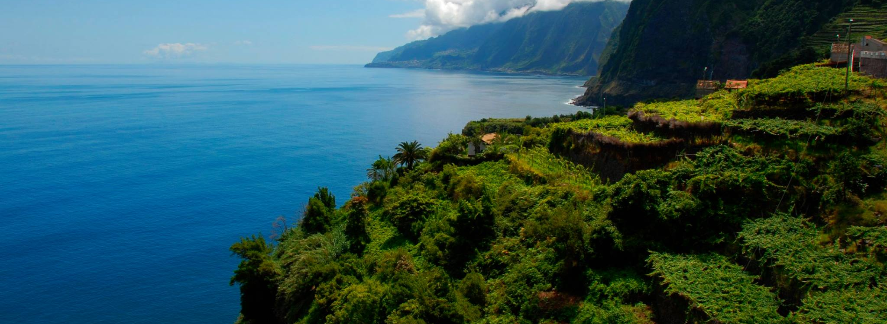
Total area: 741 Km²
Madeira Wine _ The Island

Slide 5
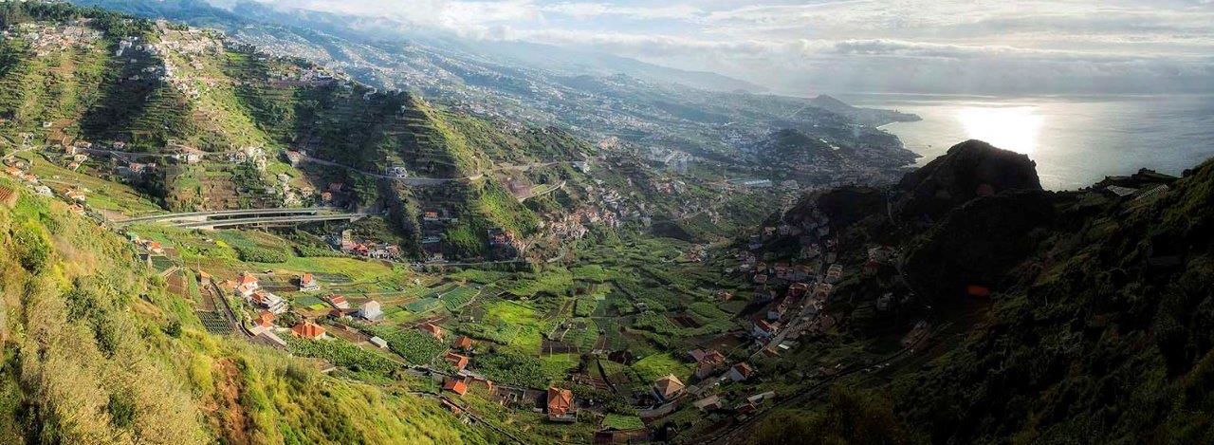
Madeira Wine _ The Island

Slide 6
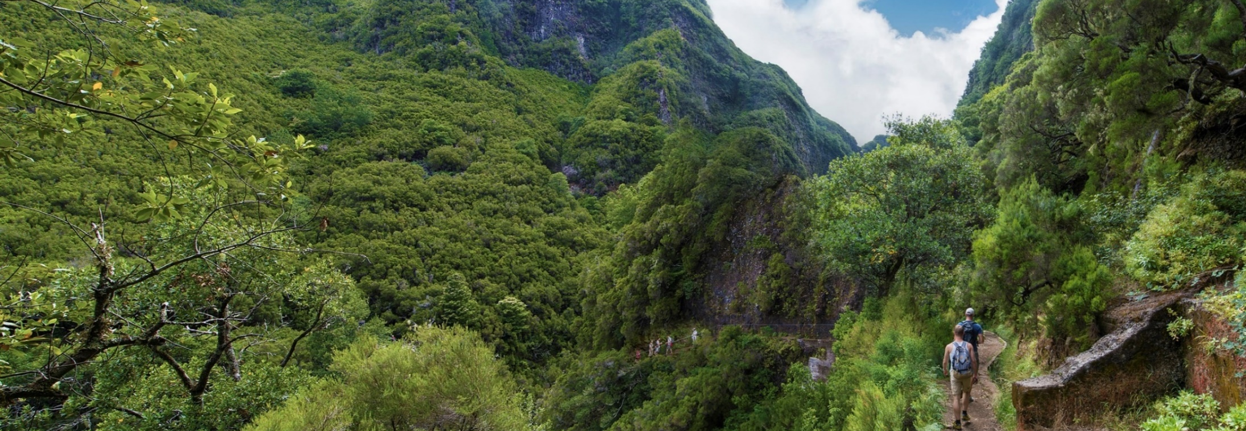
Madeira Wine _ The Island

Slide 7
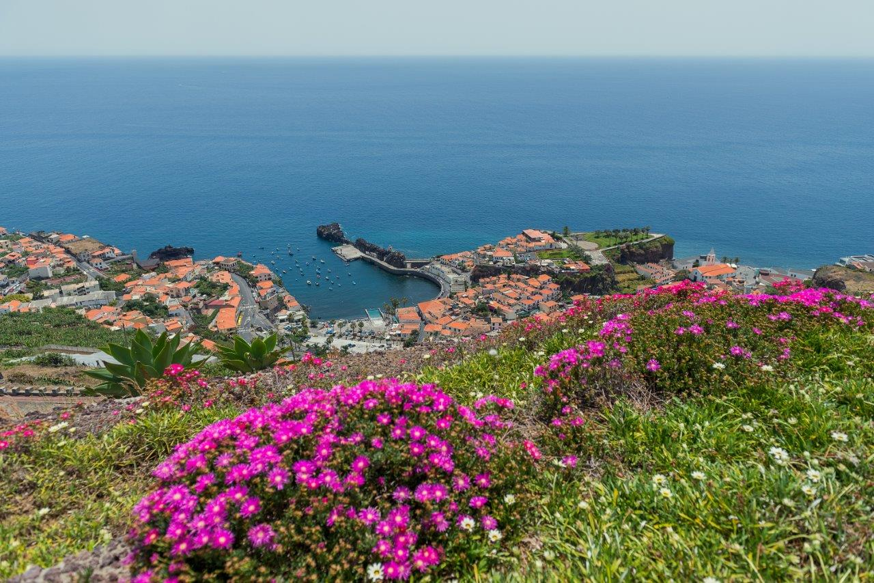
Madeira Wine _ The Island

Slide 8
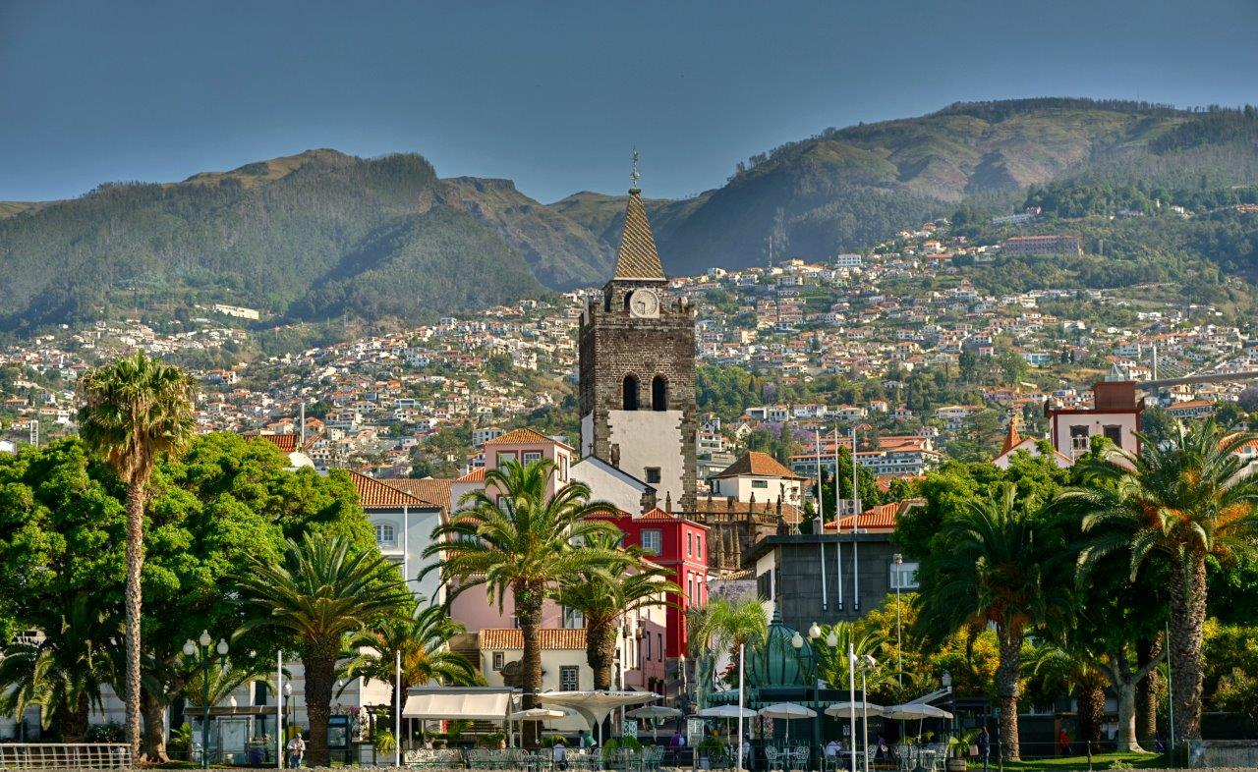
Madeira Wine _ The Island

Slide 9
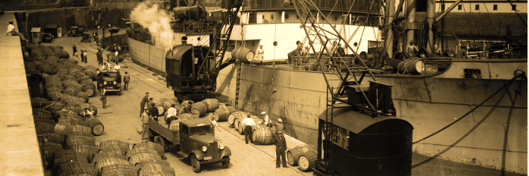
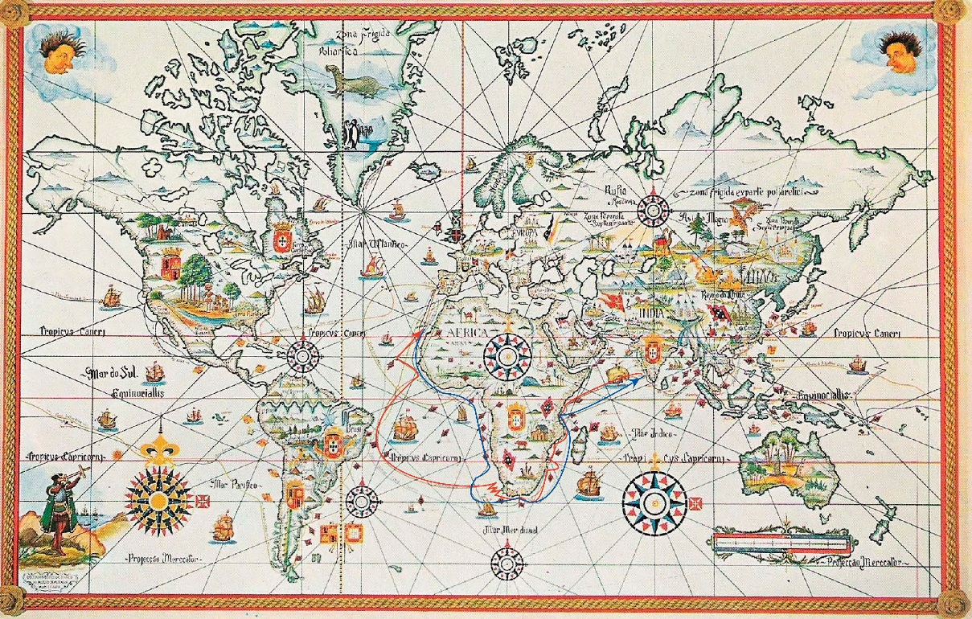
> 25 years after the beginning of the island’s colonisation,
the export of Madeira Wine had already began!
> A wine that exists almost for more than 6 centuries
> Historical commercial relations with the most diverse markets inside and outside Europe
> Exported and appreciated worldwide
Madeira Wine _ An Historic Wine

Slide 10
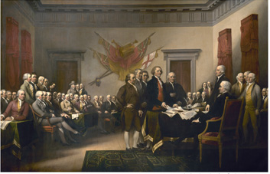
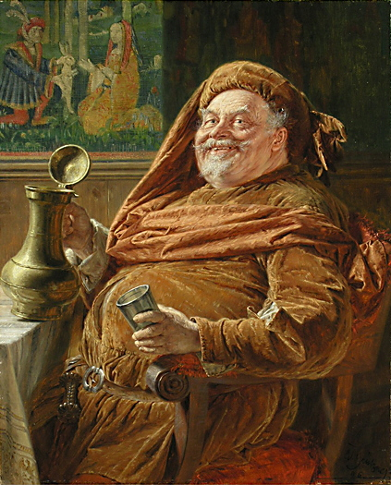
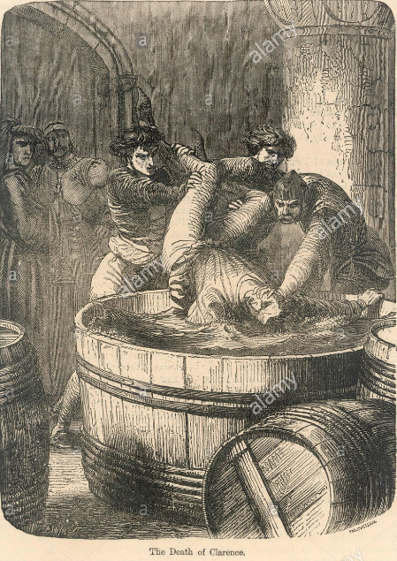
Appreciated in European courts, from Russia to England;
Celebrated the United States of America Independency;
Loved by poets;
Appreciated by explorers and adventurers;
Inspired artists;
Made history around the world.
Madeira Wine _ An Historic Wine

Slide 11
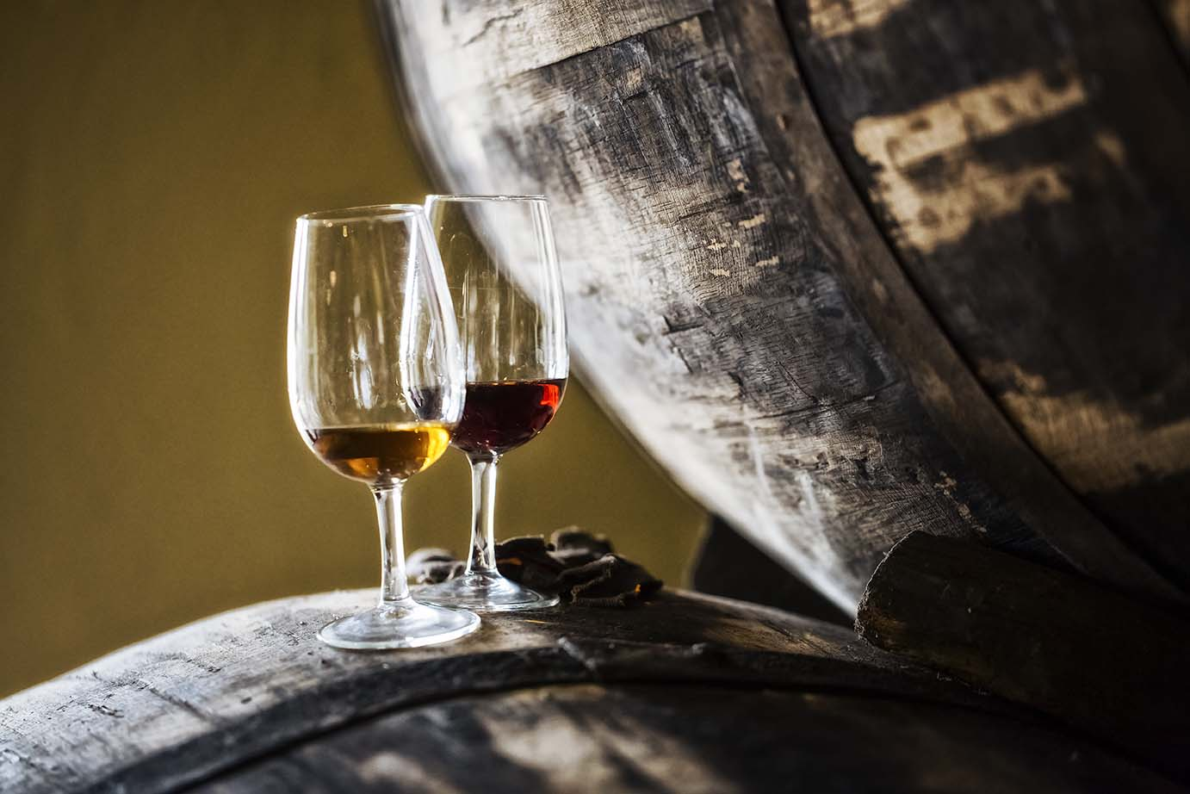
Microclimates and soils
Orography & Landscape
Grape varieties
Natural and human factors
Method of production
Traditions and Culture
Demarcated Region of Madeira
Certified product
Madeira Wine _ Communication vectors

Slide 12
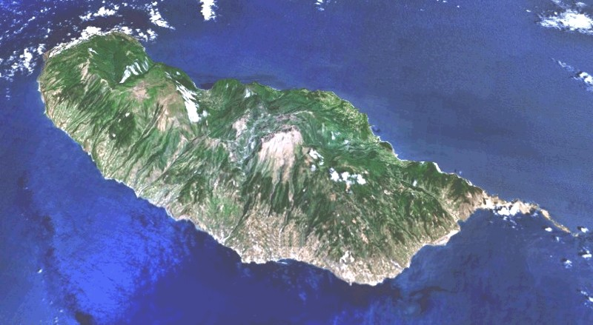
High central mountain range;
North – moderate climate;
South subtropical climate dry or moderate with Atlantique influence;
Tropical winds (north east to west direction);
Microclimates (every 100mt up the mountain, the temperature falls down 1ºC);
In general: Hot summers, mild winters, high humidity
Soils:
Volcanic soils (mainly basaltic)
Rich in organic matter and minerals (rich in magnesium and iron, poor in potassium and suffice in phosphorous)
Acid to very acid
NORTH COAST
North East
SOUTH COAST
Madeira Wine _ Climate and Soils

Slide 13
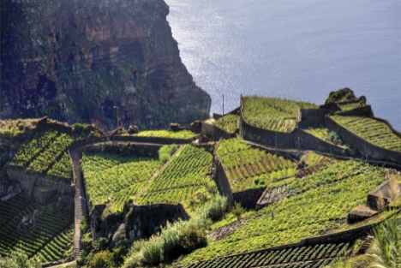
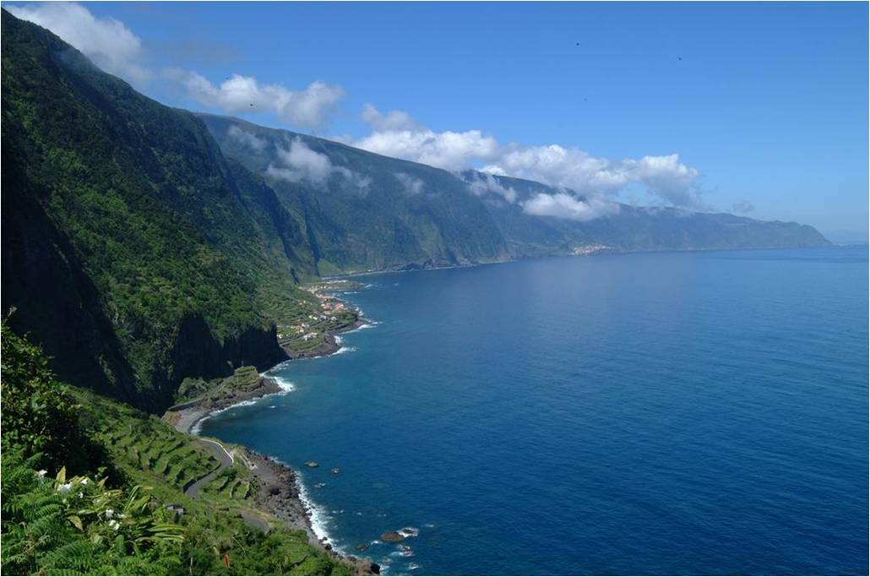
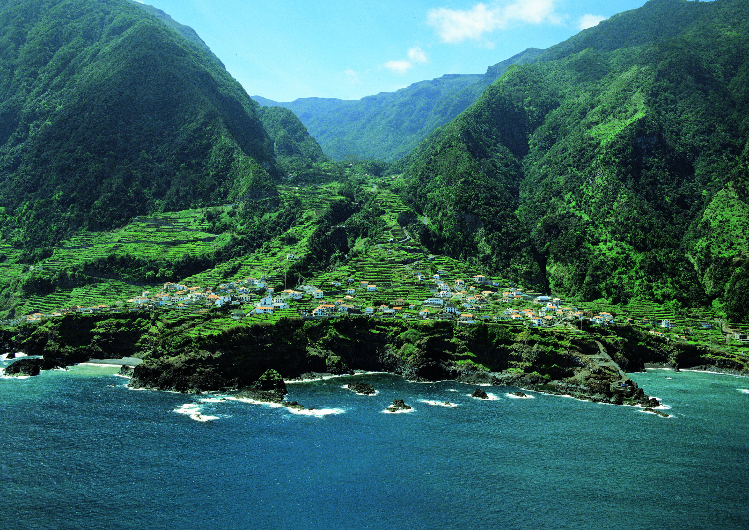
47% of the island’s total area are mountains and forests
Most of the agricultural area is found in slopes between 0/200 in some areas up to 700 meters
Landscape: Poios or socalcos
Madeira Wine _ Orography & Landscape

Slide 14
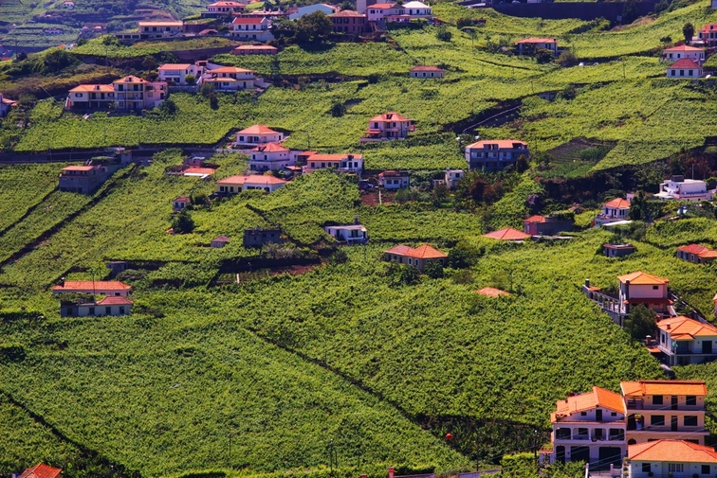
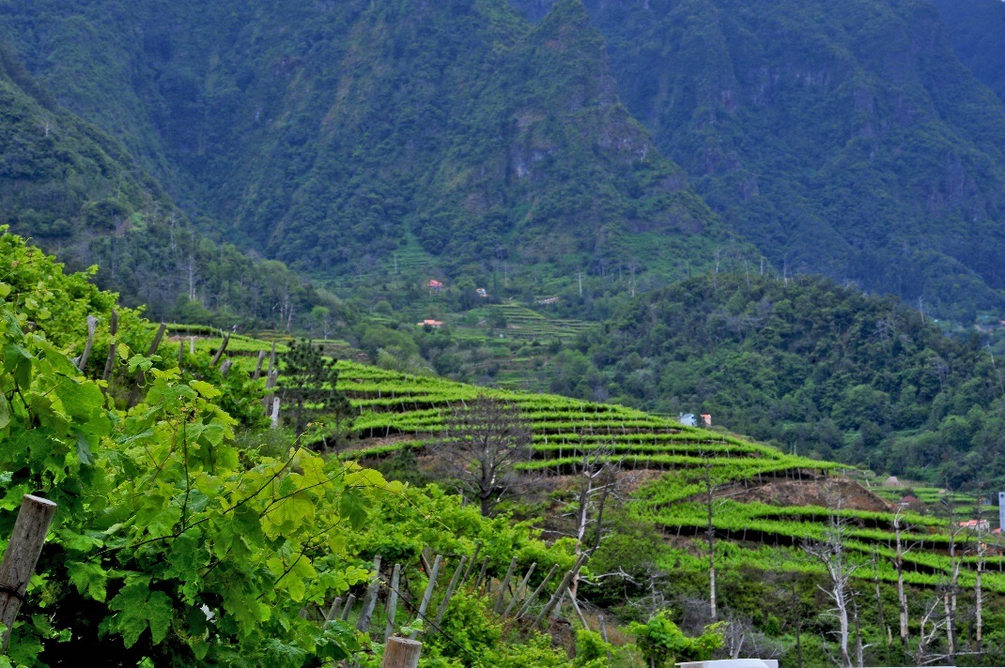
Total area of vineyards – Vitis Vinifera ~ 400 hectares
Viticultural explorations average area: 3000m2
~ 1600 Winegrowers
Madeira Wine _ Orography & Landscape

Slide 15
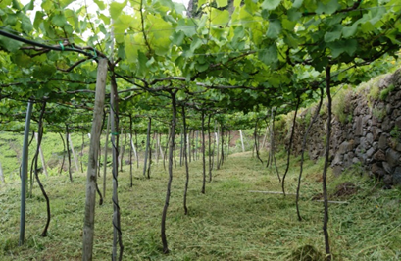
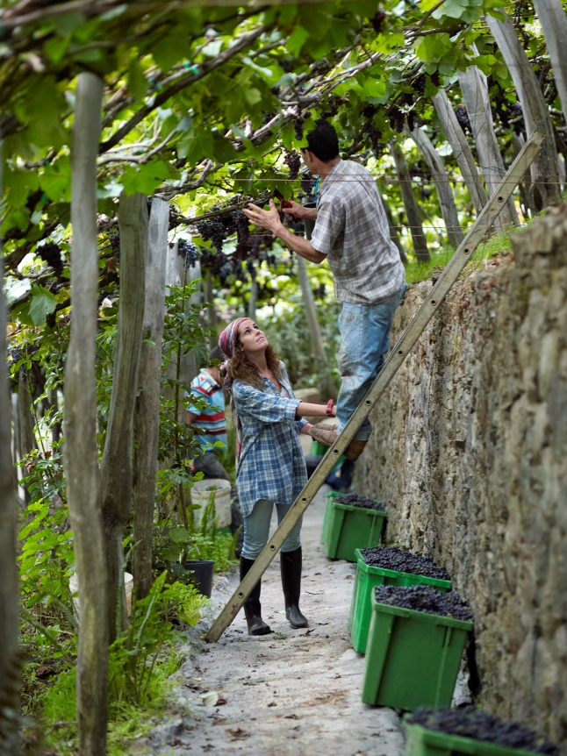
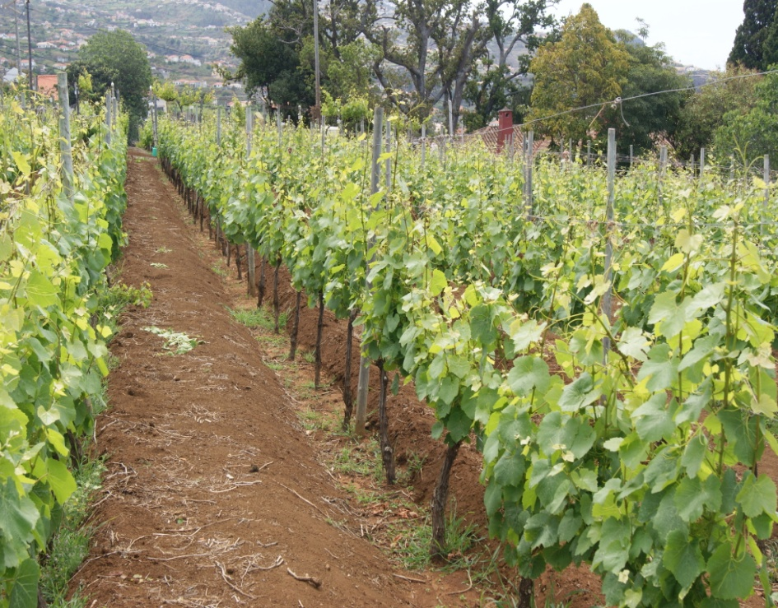
“Latada”
“Espaldeira”
Madeira Wine _ Orography & Landscape

Slide 16
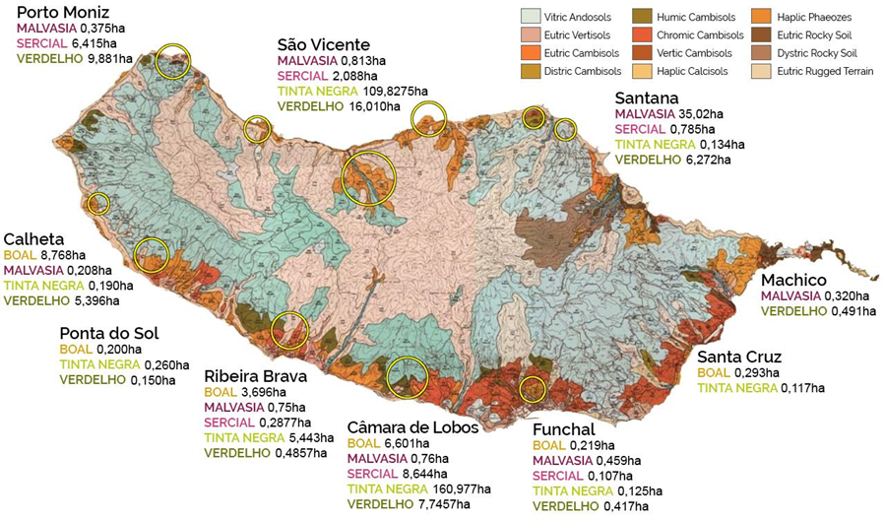
Madeira Wine

Slide 17
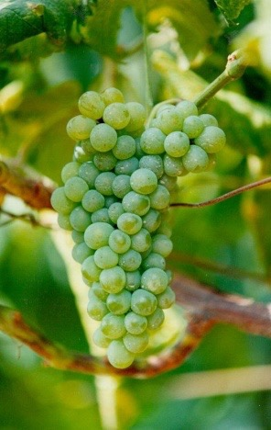
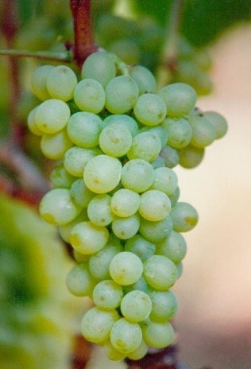
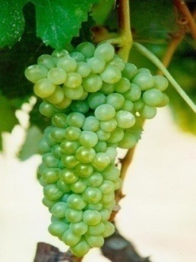
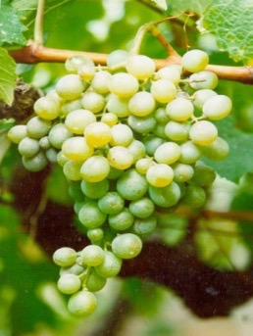
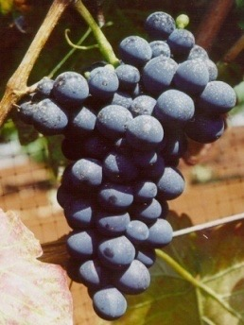
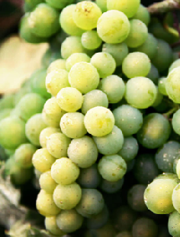
SERCIAL
VERDELHO
BOAL
MALVASIA
TINTA NEGRA
TERRANTEZ
dry
Pale
extremely fresh
crispy level of acidity
medium dry
golden color, extremely elegant
tropical and exotic character
medium sweet
amber color, medium bodied
rich in flavours
sweet
full-bodied, medium dark to dark wines
bouquet reveals honey and spice
from dry to sweetversatile grape that produces all kinds of Madeiras
medium dry or medium sweetfrom pale and topaz to amber color
exuberant bouquet
Very balanced wineLong persistent and pleasant aftertaste
Madeira Wine _ Grape Varieties

Slide 18
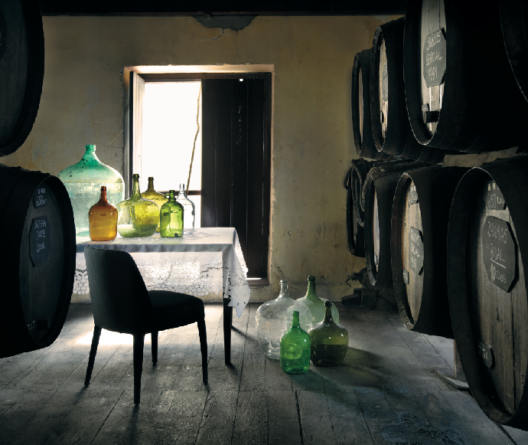
Fermentation stops by the addition of neutral alcohol of vinous origin at 96%vol.
Madeira wines | Baumé scale (ºBé) | Sugars (g/l)
Extra dry | < 0,5 | ≤ 49,1
Dry | < 1,5 | ≤ 59,3
Medium dry | 1,0 ≤ ºBé < 2,5 | 54,2 ≤ Sugars(g/l) ≤ 78,1
Medium sweet | 2,5 ≤ ºBé ≤ 3,5 | 78,1 ≤ Sugars(g/l) ≤ 100,04
Sweet | > 3,5 | ≥ 100,04
Terrantez
Fortified Wine – 17-22% vol. alcohol content
Madeira Wine _ Method of production - vinification

Slide 19
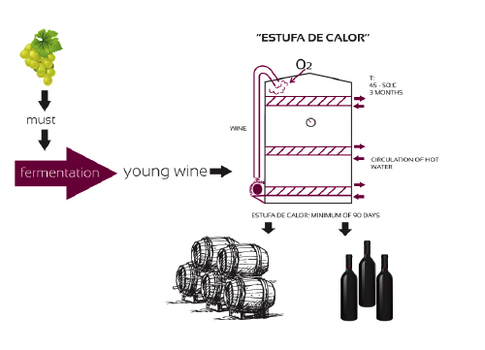
Colour evolution
Pronounced oxidation of the wine due to higher temperatures
Chemical reactions (aromas of dried fruits, apple, …)
Madeira Wine _ Method of production - estufagem

Slide 20
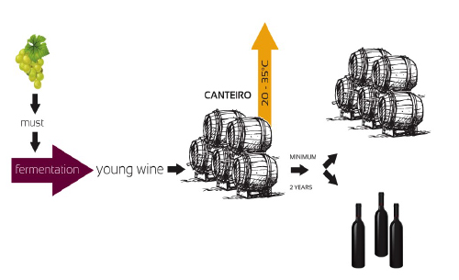
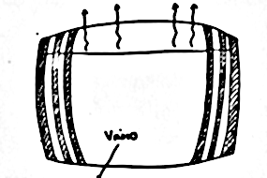
Water evaporation
T: 25-35ºC
70-75 % HR
H₂O
H₂O
H₂O
H₂O
Wine
· CANTEIRO: wooden support beams
· AGED in casks
· TOP FLOORS of wine cellars (higher temperatures)
Colour evolution
Wine concentration :
↑ extract, acids, sugars, alcohol content
Slow chemical reactions
Madeira Wine _ Method of production - canteiro

Slide 21
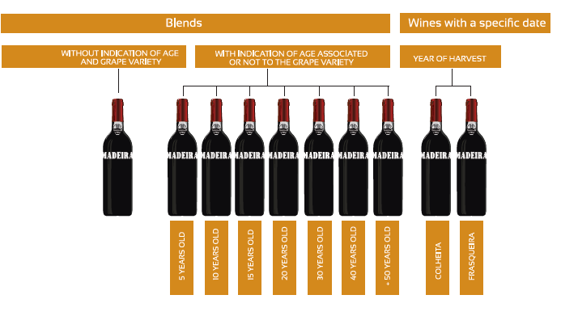
Madeira Wine _ Madeira Styles

Slide 22
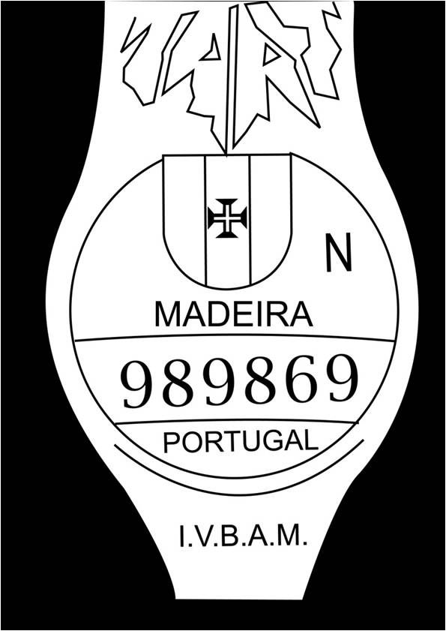
One of the oldest in Portugal and its future passes through a continuous commitment to quality.
Madeira Wine is subjected to a rigorous quality control conducted by IVBAM
Quality is the result of the joint commitment of public and private sectors, in a certification system with a solid engagemet to the future.
Madeira Wine _ Demarcated Wine Region and Certified Product

Slide 23
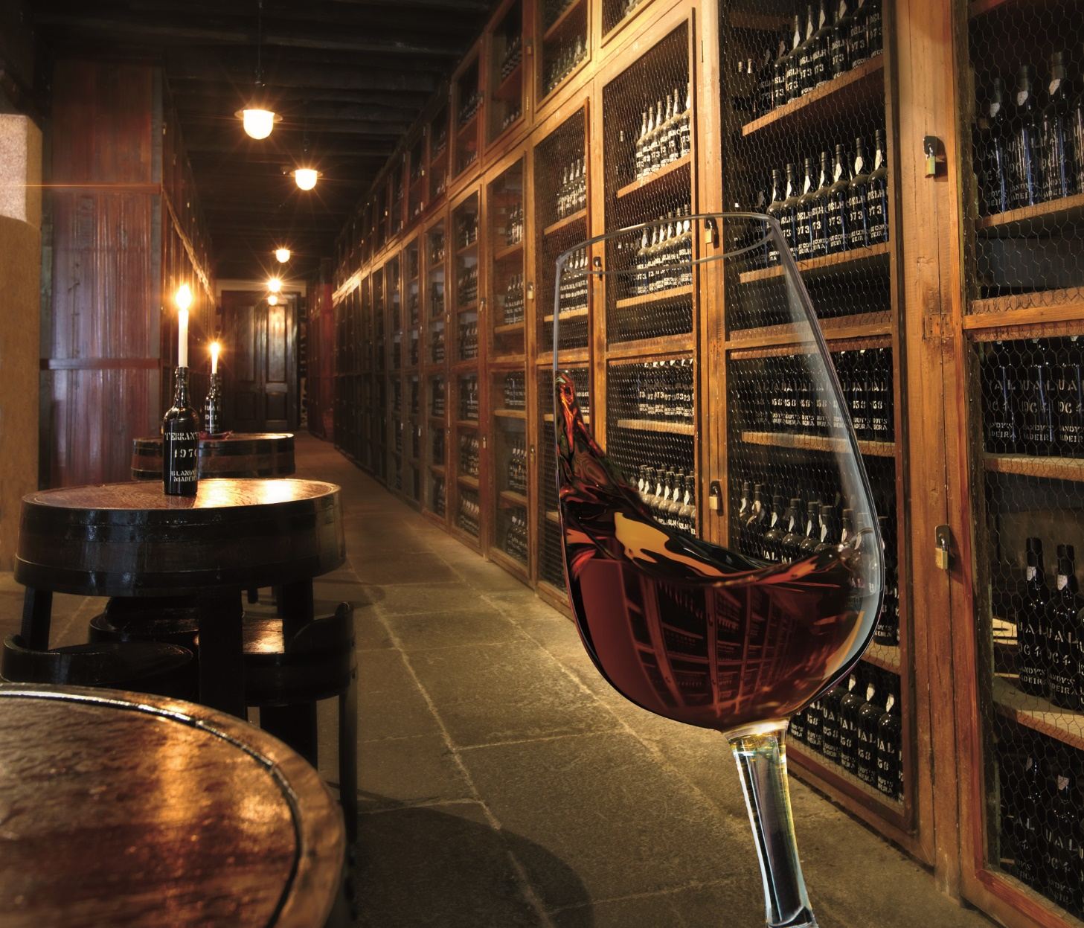
complexity
exuberant bouquet
acidity/freshness
great longevitym
Madeira Wine _ Unique characteristics

Slide 24
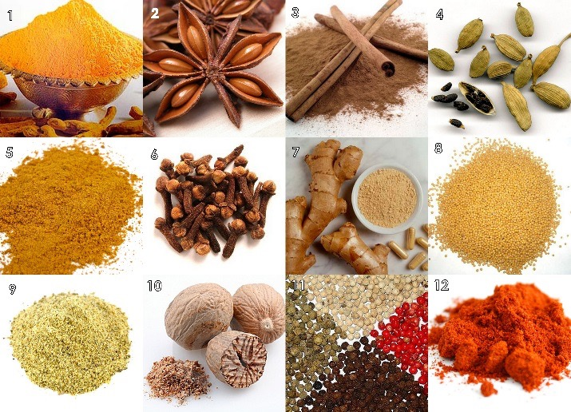
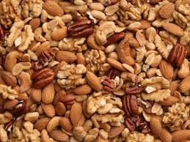
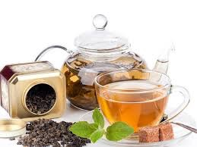
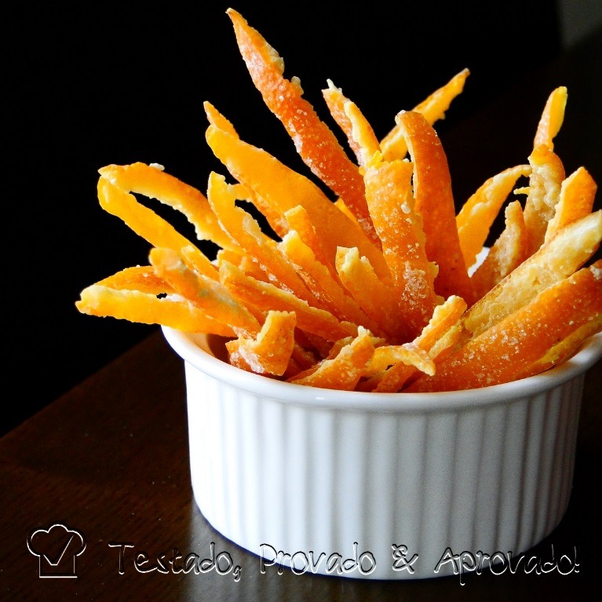
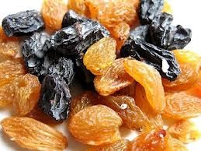
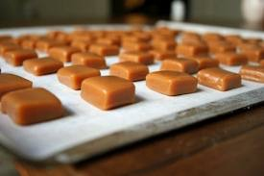
Apple
Pine
Burnt sugar
Eucalyptus
Dried Fruits (raisins, figs)
Nuts (almond, hazelnuts)
Chocolate
Cinnamon
Orange zest
Varnish
Coffee
Tobacco
Cocoa
Caramel
Tea
Honey
Brown sugar
Madeira Wine _ Unique characteristics- Aromas and flavours

Slide 25
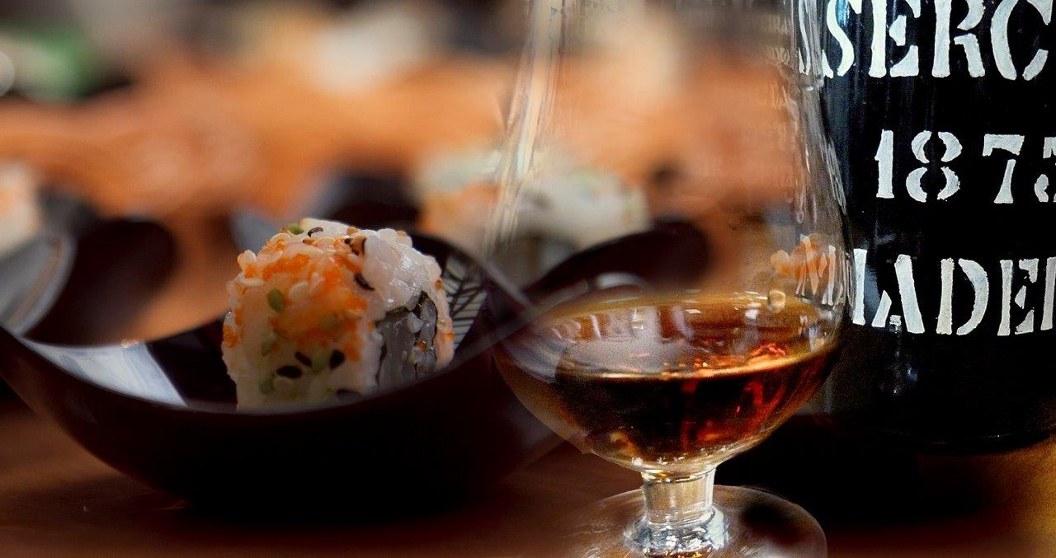
Madeira Wine can be paired with a vast repertoire of gastronomic combinations varying according to the wine’s degree of sweetness.
The associations are delicious and infinite.
Madeira Wine _ Unique characteristics- Foodparings

Slide 26
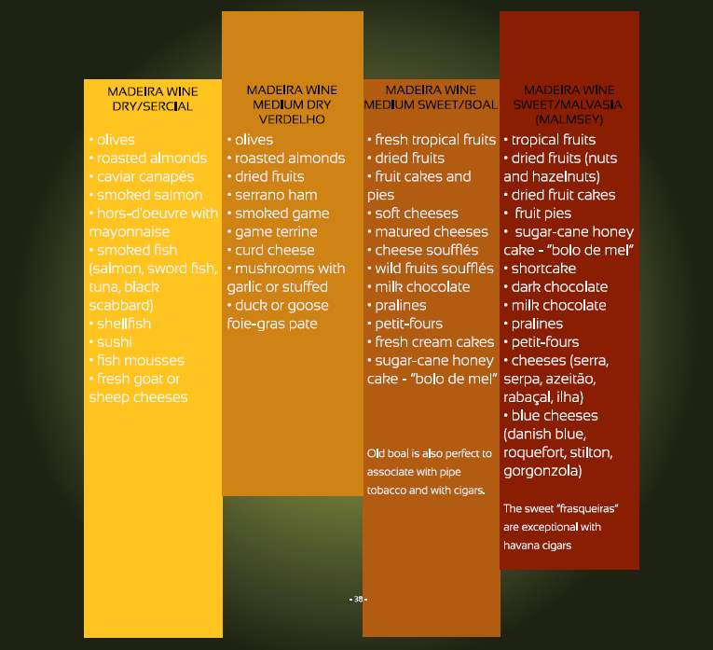
The proposed combinations of food with Madeira wine are endless.
Madeira Wine _ Aromas and flavours

Slide 27
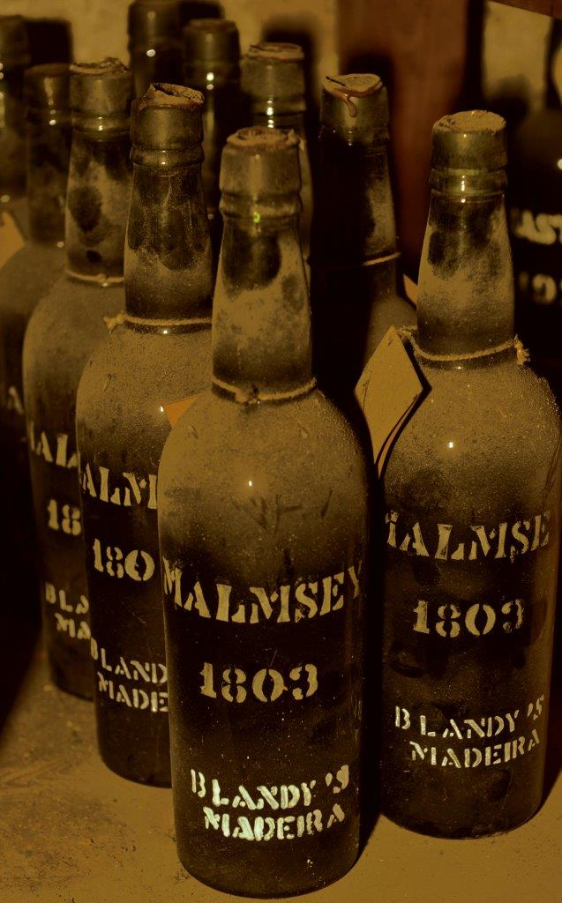
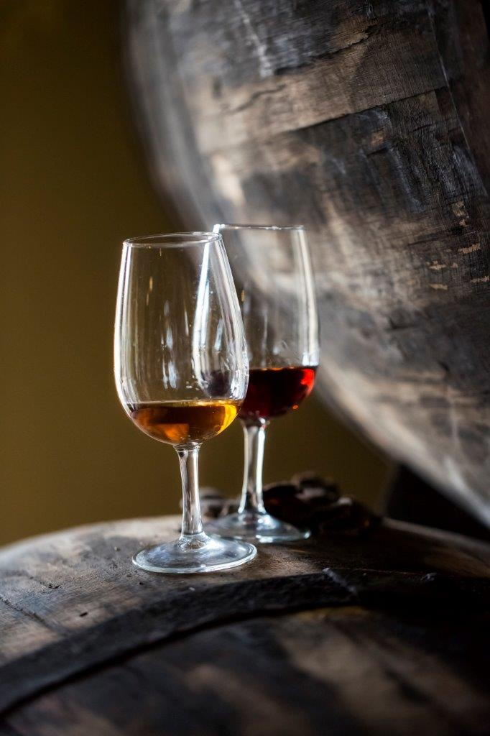
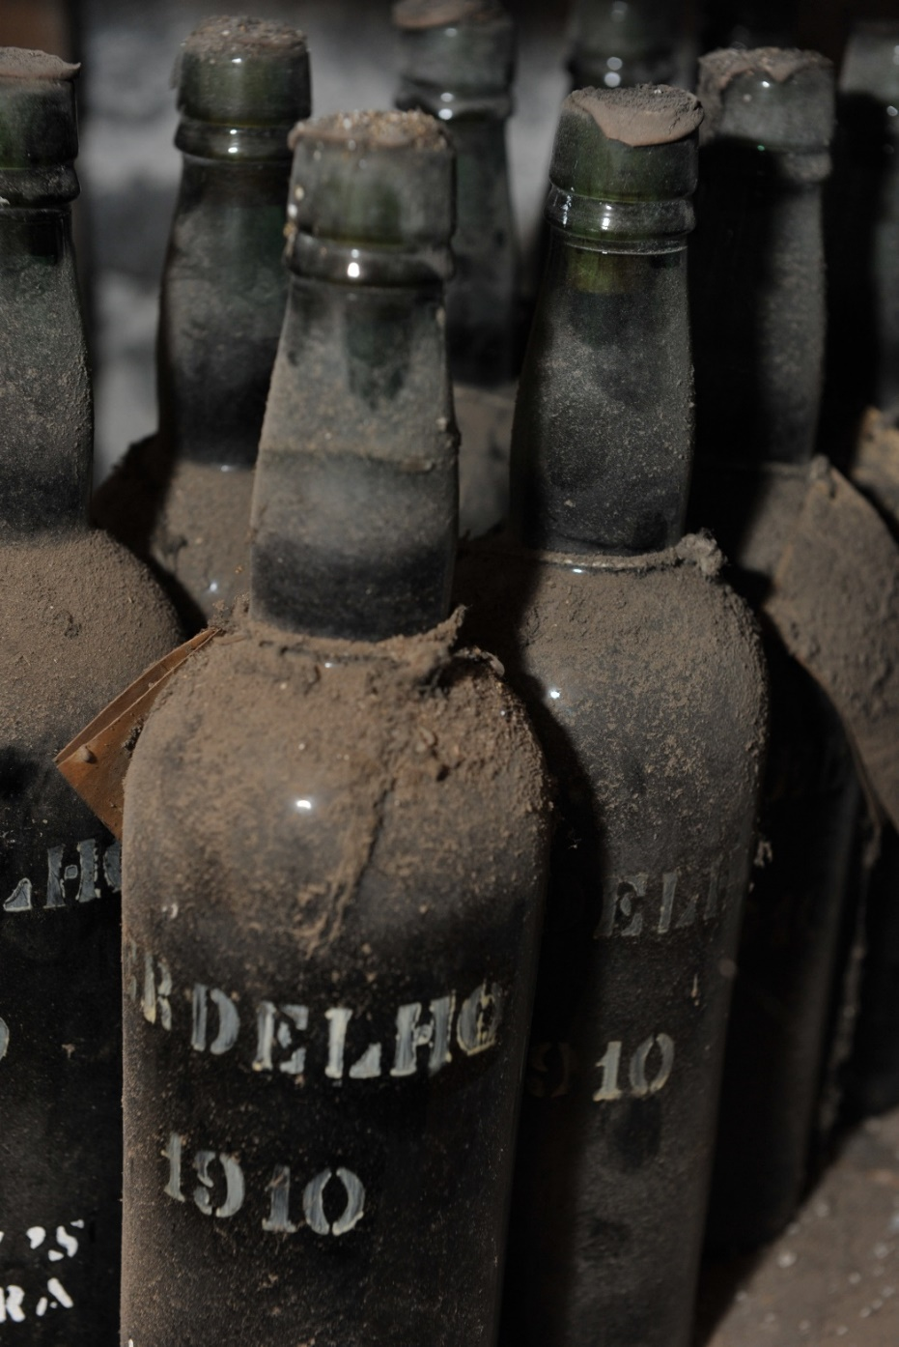
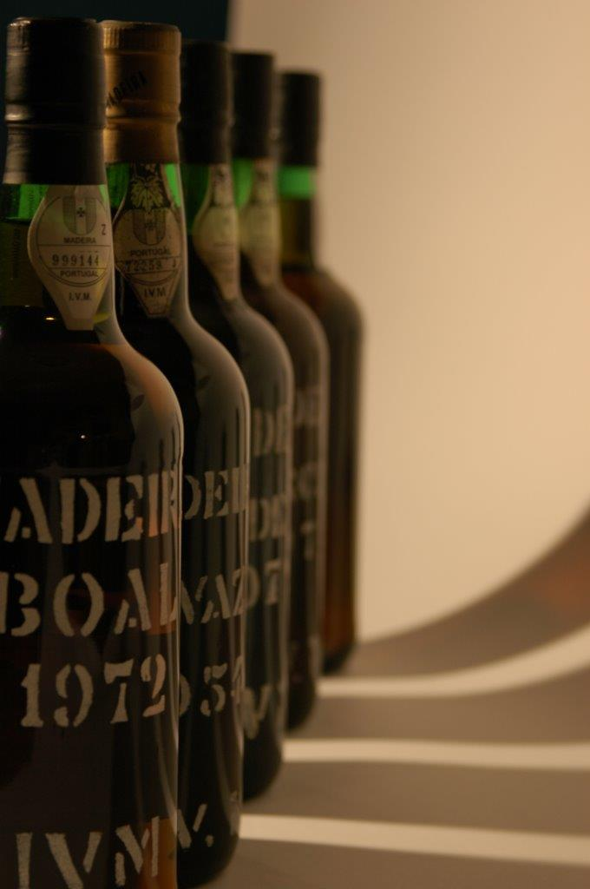
It is one of longest-lived wine in the world, that can remain vibrant, complex and exciting after a century or more.
Madeira Wine _ Unique characteristics - Longevity

Slide 28
Minimum of 3 years old
No indication of age or grape variety: dry to sweet.
Blends
With indication of age:
5, 10, 15, 20, 30, 40, 50, >50 years old; with or without grape variety.
Harvest year
Colheita: min. 5YO; indication of harvest year; with or without grape variety.
Solera: min. 5YO by canteiro system; indication of harvest year; with grape variety.
Frasqueira: min. 20YO by canteiro system; with grape variety.
With grape variety: Sercial, Verdelho, Boal, Malvasia, Tinta Negra, Terrantez, Bastardo;
Without grape variety: extra dry, dry, medium dry, medium sweet and sweet.
Madeira Wine _ Understanding the label

Slide 29
AN INDESTRUCTIBLE
WINE
Can be stored in
any position
EFFICIENT
&
RESISTANT
BY
THE GLASS
Madeira Wine _ Advantages for bars and restaurants

Slide 30
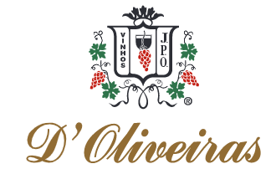



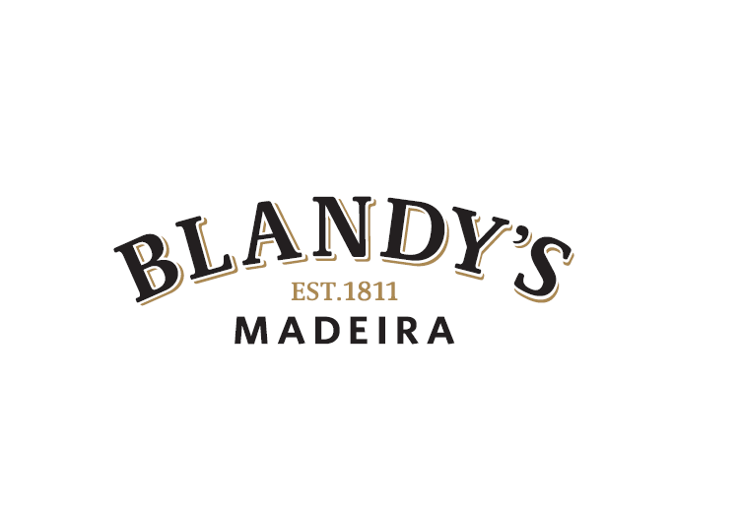
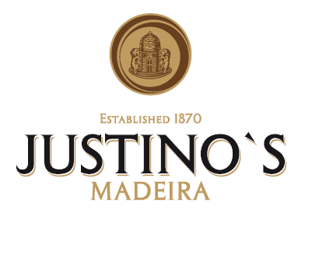
Madeira Wine _ Producers

Slide 31

Pereira D’ Oliveira (Vinhos), Lda. is an independent and family-owned company, dedicated to the production, marketing and export of Madeira wine, which has been run since the beginning of the 70’s by three brothers Luís, Aníbal (deceased in June 2017), and Miguel (deceased in August 2018), direct descendants, on the paternal side, of the Founder João Pereira D’ Oliveira, and, on the maternal side, of João Joaquim Camacho. This wine company represents five generations of vast knowledge and experience dedicated to the production of the fortified wines of Madeira, and is currently run by Luís D ‘Oliveira, the partner in the company responsible for the business, marketing, export and innovation, and by Filipe D’Oliveira (Aníbal’s son), the other partner who belongs to the sixth generation and who has been in charge of the production and oenology since 2002. We highlight the fact that our oenologist has always been a family member, who, from a very young age has gradually been acquiring knowledge and experience from the previous generation, in order to ensure the continuity of the house that guarantees its secular identity.
Madeira Wine _ Winery

Slide 32

1. D’OLIVEIRAS
3 Year Old Sweet
Grape varieties:
Tinta Negra
Technical specifications:
Alcohol %Vol. 20% 18,75
Density 20%C 1,03594
Baume 5,3
Volatile acidity (acetic acid) g/l 0,30
Dry extract – total 158,6
Total sugar g/l 147
Extract not reducing g/l 11,5
Tasting Notes
Madeira Wine _ 3 Year Old Sweet
Madeira Wine _ 3 Year Old Sweet

Slide 33

Vinhos Barbeito entered the wine business in 1946, during a particularly dark time for Madeira. During World War II, production and sales had ground to a virtual halt. As a result, far more companies were leaving the business than were joining. But Mario Barbeito had faith in the future. He also believed that the value of great Madeira could only go up as it became older and production of young vintages declined. But while Barbeito saw those vintage wines as a nest egg for the future, he was content to let the wines age. He wisely built the business in the early years around more modest Madeiras.
It was left to his daughter Manuela - when she gradually took over the business from him in the 1970s to continue his work. In the mid 1990s, Manuela Barbeito began to turn over the reins of the company to her son Ricardo Freitas. He not only brought a deep respect for Madeira’s classical roots, but also brought new energy and new ideas to the company. One of these ideas was to restore the role that Madeira once had as a companion to food. Ricardo is continuing his grandfather’s and mother’s legacy of making wines and preserving them for future generations. But he is also creating his own legacy: a series of Madeiras he calls his “Signature” wines. These handcrafted wines combine the best elements of Madeira’s classical tradition with Ricardo’s own quest for purity and vineyard and varietal expression. Made in tiny lots, their astonishingly graceful style has prompted British wine critic Jancis Robinson to call Barbeito the “Lafite of Madeira”.
Madeira Wine _ Winery

Slide 34

2. BARBEITO
Rainwater Reserva Medium Dry
Grape varieties:
80% Tinta Negra and 20% Verdelho
Technical specifications:
Alcohol: 18,10% vol.
Baume: 1,95
Total sugar: 70 g/l
Volatile acidity: 0,42
Total acidity: 6,41
pH: 3,33
Tasting notes and harmonies
Light gold colour.
Aromatic nose with notes of dried fruit, orange blossom and crystallized fruit. Full, round with an extreme softness. Long and mineral fresh finish.
Excellent as an aperitif, with salted nuts and olives.
Madeira Wine _ Rainwater Dry Reserve

Slide 35

BLANDY’S MADEIRA
The Blandy family is unique in being the only family of all the original founders of the Madeira wine trade that still own and manage their own original wine company, nowadays managed by Chris Blandy – 7th generation. Throughout its long history on the island the family has played a leading role in the development of Madeira wine and members of the family continue to live in Madeira maintaining a tradition that goes back to 1811.
COSSART GORDON
Established in 1745, Cossart Gordon & Co. represents the oldest company in the Madeira trade. It was originally founded by Scotsmen, G. Newton and W. Gordon who were later joined by W. Cossart, in 1808. The company established a reputation as suppliers of the finest of Madeiras mainly due to their trade relationship with America. The firm today enjoys an unrivalled reputation as one of the finest producers of Madeira Wine.
MILES MADEIRA
Established in 1814, Miles Madeira is synonymous with excellent Madeira wine and is one of the best known and most respected brands in the world. Today, Miles Madeira as become a Tinta Negra grape specialist, producing versatile wines perfect for cocktails or food pairing.
Madeira Wine _ Winery

Slide 36

3. BLANDY´S
Blandy's 10 YO Sercial
Grape variety: Sercial
Soil Type: Different types of soils of vulcanic nature, derived mainly from basalt, trachytes, tufa, slag and conglomerates.
Technical specifications:
Alcohol – 19%
Volumetric mass – 1004 g/L
Total acidity – 6,80 g/L
Volatil acidity – 0,42 g/L
Residual Sugars – 55 g/l
Ph – 3,35
Baumé – 1,1
Tasting Notes
Bright crystalline golden citrine colour with golden reflections. It presents a characteristic bouquet of dried fruits macerated in brandy, dried and bitter almonds, candied citrus fruits, and spices. The attack is dry with a pleasant sensation of citrus freshness and dried fruits such as hazelnuts, with a long finish leaving notes of spices and exotic wood.
Madeira Wine _ Blandy's 10 YO Sercial

Slide 37

The history of Henriques & Henriques goes back to 1850 when the company was founded by João Gonçalves Henriques, a descendant of a family that established itself in Câmara de Lobos many years ago. After his death in 1912, his sons, João Joaquim and Francisco Eduardo Henriques, formed a partnership from which the name “Henriques & Henriques” originated. The last of the Henriques died in 1968 and the company passed on to his closest collaborators and friends.
The transmission of knowledge and tradition in the making of fine Madeiras continues to the present day. H&H is the only company to have continuously owned vineyards, resulting in the production of extremely high-quality grapes, namely Verdelho and Terrantez, which allows for a better control of production. It also acquires grapes from various wine growers with whom it has a close and long-standing relationship. The construction in 1992 of the new ageing winery in the parish of Câmara de Lobos, where the head office and the commercial area are also located and the vinification centre in the parish of Quinta Grande gave the company the adequate means to meet the demands of the markets, using the most recent technological innovations, whilst maintaining the family tradition of almost 200 years in the production of the best Madeira wines.
Madeira Wine _ Winery

Slide 38

4. HENRIQUES & HENRIQUES
BOAL 10 YEARS OLD
Grape variety: Boal
Tasting Notes
A dark amber Madeira with greenish nuances. Full and soft body, with a slightly sweet taste of raisins, honey and some wood. A fresh and rich wine that offers a long and pleasant finish.
Technical specifications:
Alcohol %Vol.20ºC
Relative Density 20/20
Baumé
Volatile Acidity (acetic acid) g/l
Total Acidity (tartaric acid) g/l
Total sugar g/l
Remnant Extract g/l
20,0
1,022
3,4
0,94
6,63
97,0
28,0
Madeira Wine _ H & H BOAL 10 YEARS OLD

Slide 39

H.M. Borges has as its basic elements the excellence of quality associated with technological evolution, maintaining the traditional values of Madeira Wine production. Founded in 1877 by Henrique Menezes Borges, the company H.M. Borges Sucrs. Lda assumes itself as one of the main brands of Madeira Wine, having an excellent and considerable stock of high-quality blended wines, from which it constitutes the varied range of wines currently on the market.​
It is currently managed by the fourth generation of its family. The H.M. Borges’ mission is: To grow, produce and sell the best quality wines and the highest value to its customers, seeking to improve quality, efficiency, effectiveness and profitability and sharing responsibility for solving problems, maintaining a healthy environment.​
Madeira Wine _ Winery

Slide 40

COCKTAIL: FIG HIGHBALL
H.M. Borges
3 years old medium dry
Grape varieties: Tinta negra (100%).
Technical specifications:
Alcohol: 18.0% Vol
Total Acidity: 6.0 g/l
Total Sugars: 67.0 g/l
Baumé: 1.8
pH: 3.19
Ingredients:
H.M. Borges, 3 YO Medium Dry
Coconut
Fig leaf soda
Tasting notes and harmonies
This Madeira Wine of 3 Years Medium Dry has an amber color with yellow-orange nuances.
The aroma contains some notes of wood, caramel and tea. On the palate it has a balanced
acidity, with a clean finish.
Madeira Wine _ 3 years old medium dry

Slide 41

Justino’s, Madeira Wines, S.A. is established in Madeira Island since 1870 and is one of the ancient producers and exporters of Madeira wine which ever had an outstanding position on the market, for its certified good quality wines. Till 1953 it was a familiar enterprise, established in the old area of Funchal. At 1993, got internationalized, making an association with one of the largest French groups of wine and spirit distribution, building a new winery for the purpose of improving the conditions in which its wines are made, in particular the process of vinification, production and aging. This large, modern and functional vinery has been equipped so as to combine traditional methods with the most advanced technology available. For over a hundred years, wines from Justino ́s Madeira have been increasingly popular throughout Europe. Main markets include France, Germany, England, Austria, Switzerland, Poland, the Benelux countries, Spain and Scandinavia, in Europe, as well as in the United States, Japan, China, South Korea, Brazil and Canada. Today, Justino ́s Madeira Wines, S.A. holds one of the largest stocks of Madeira Wine on the Island, including high quality wines aged in oak casks, which enables the company to meet the requirement of the most demanding and selective consumers. Over the years, Justino ́s, Madeira Wines, S.A. has become one of the leading producers and exporters of Madeira Wine thanks to the acknowledged quality of its wines and the substantial increase in its production capacity.
Madeira Wine _ Winery

Slide 42

COCKTAIL: SMOKY MADEIRARITA
Justino´s Madeira Wines
FINE MEDIUM DRY RESERVE 5 YEARS OLD
Tasting Notes
Appearance: Brilliant golden colour.
Nose | Taste: A pleasant and intense aroma,
with a suggestion of dry fruit and rich honey. Appealing flavours of dried citrus fruits.
Long dry and complex finish, with a walnut note on finish.
Grape varieties: Tinta negra (100%).
Technical specifications:
Alcohol: 19% vol.
Total Acidity: 6.40 g/l (as tartaric acid)
Total Sugar: 70 g/l
Baumé (Bé): 2.0
Ingredients:
Justino’s, 5 YO Medium Dry
Humo Chipotle
Grapefruit
Salt
Madeira Wine _ FINE MEDIUM DRY RESERVE 5 YEARS OLD

Slide 43












Slide 44


