Slide 1
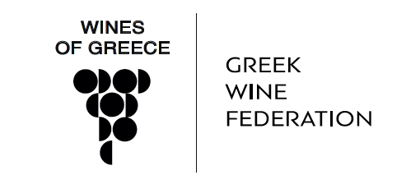
Viticulture

Slide 2
History
Long, thousands of years wine history and culture.
Famous ancient wines with designation of origin
Symposia: Intellectual gatherings where wine served as a social lubricant-always in moderation and diluted with water
Greek colonies spread out the art of making wine
Byzantine Empire – wines are exported to the Medieval Europe by Venetian traders. Wine highly connected to religion
Notes:
During classical times the Greeks had a well regulated wine trade. An early system of appellation of origin was established, to protect the value and guarantee the authenticity of high quality wines from specific areas. Much of the European Union's complex system of regulations governing wine production and labelling bear similarities to those in practice in ancient Greece. Wine laws referring to the island of Thassos have been found engraved in marble.

Slide 3
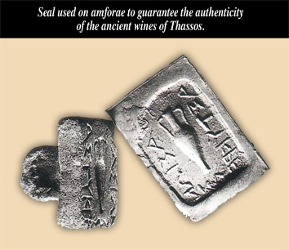
The first Appellation rules

Slide 4
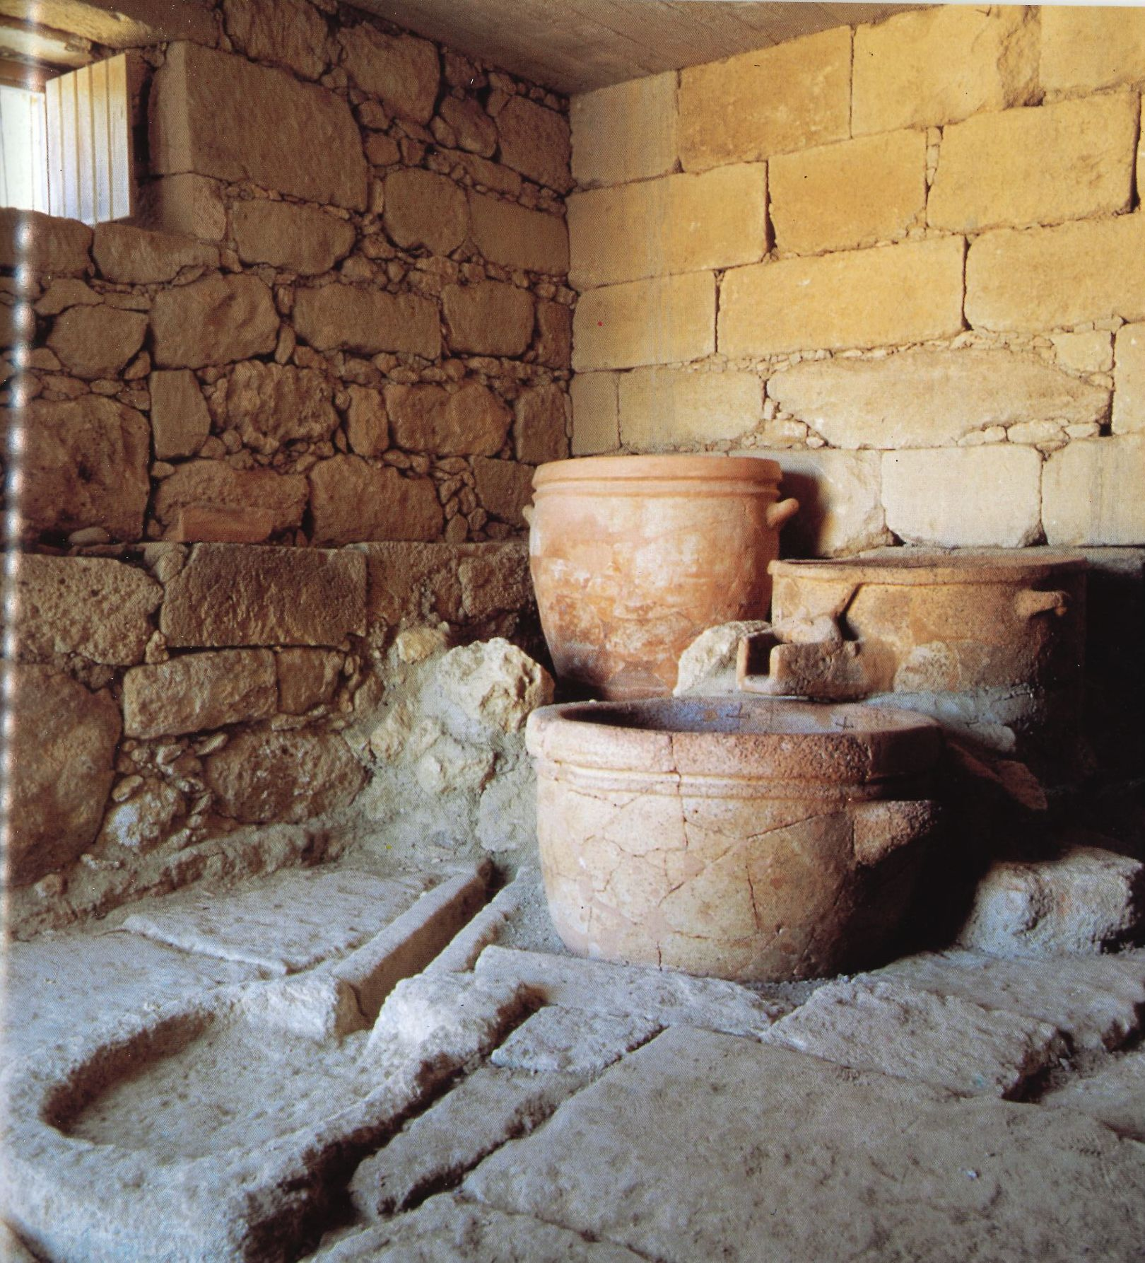
Notes:
From around 1600BC. Considered the oldest wine press found in Europe.

Slide 5
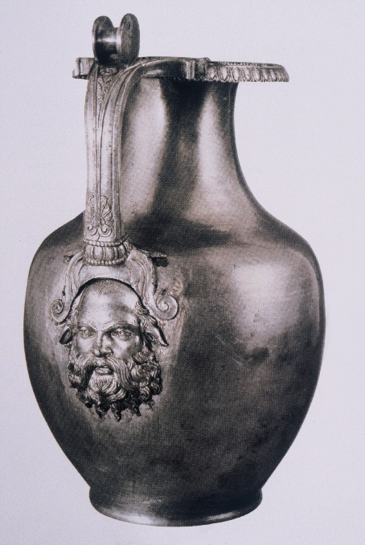
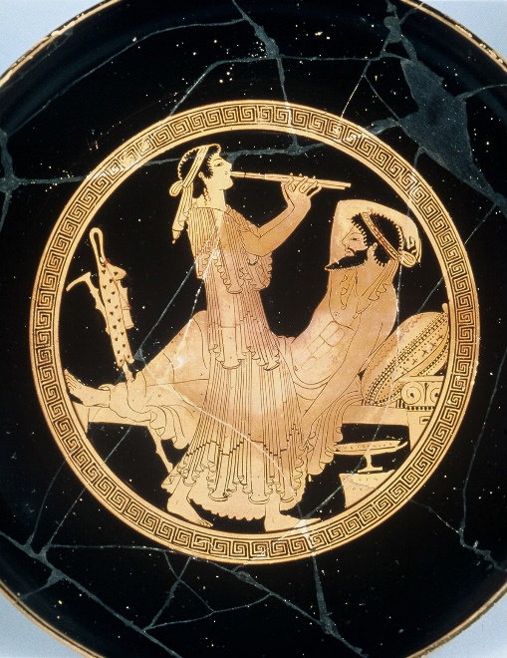
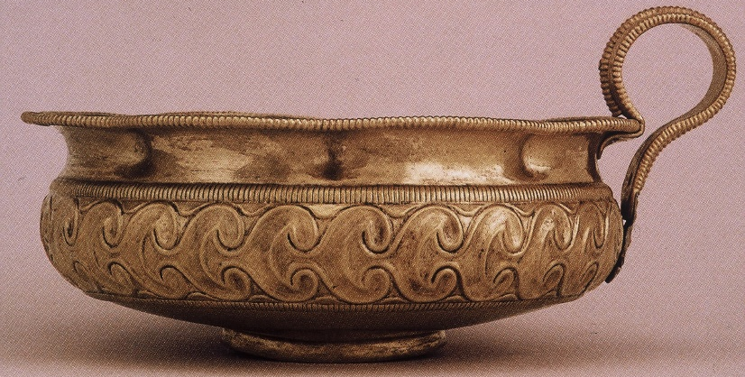
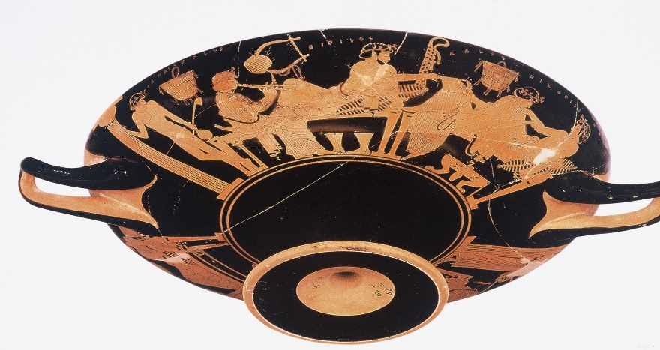
Greece: The first culture of wine
Notes:
They were not just drinking wine. They had the most sophisticated wine culture. Different drinking vessel for different occasions or wealth. The Riedels of the world.

Slide 6
Modern History
In the 19th century Greece fights for independence from the Turks. Greek state established in 1830.
Greece suffers from consecutive wars in the 20th century (Balkan, WWI & II, Civil
In the early 20th century phylloxera destroys most of the Greek vineyards
In the late 1960s and early 1970s the first official Greek wine legislation was created. The first Appellations are established
In 1980’s Greece enters the EU and investments in modern winemaking technology reaches the country

Slide 7
Modern History
Also in 1980’s the Oenology school at the Athens Technological college is established
1990’s Greek winemakers complete their studies in the top oenology schools of the world and return to Greece to introduce modern techniques. The Boutique wineries revolution is in full swing
Greek wines attract the attention of renowned international wine writers, critics and sommeliers.
Costumers seeking more authentic wines
Stand out in international wine competitions and wine shows.
Rising exports to important wine markets.

Slide 8
GREEK WINE AT A GLANCE
Τotal cultivated surface (2021 / 2022) : 64,900 Ha
Less than 0,8% of world wine production, less than 2% of EU wine
200.000 vineyard holdings, 160.000 families of vine growers
212 million litters (2022). Value 380 million euros
1600 Wineries, vast majority small family companies
300 and more indigenous grape varieties. 90% of vineyard
2/3 whites, 1/3 reds
33 PDO wines, 114 PGI Wines
15% of total wine production is exported
The main exporting country is Germany – 33 % of total exports
Export value: 100 million euros

Slide 9
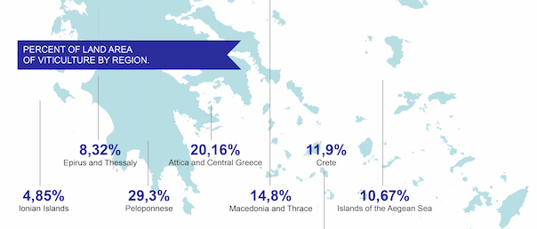
Greek vineyard area

Slide 10
Greek PDO-PGI wines

Slide 11
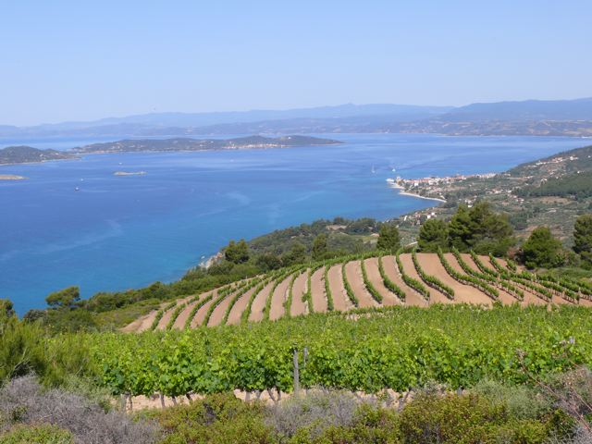
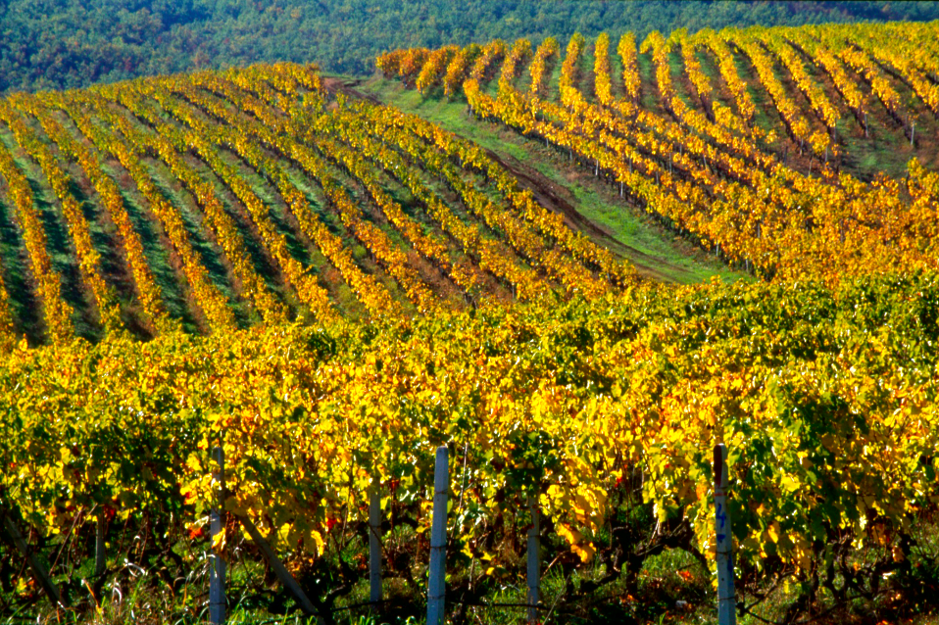
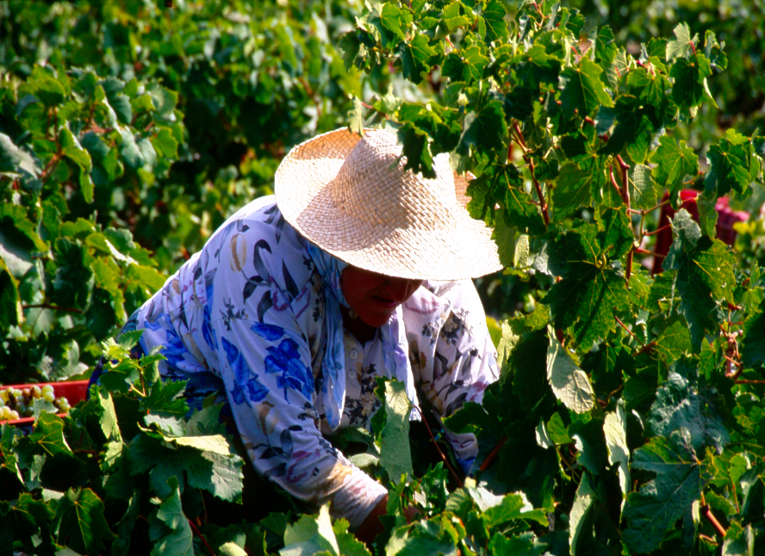
Greece: A land of contrasts
Notes:
Greece is the 3rd most mountainous country of Europe. At the same time where ever you are you are not more than an hour away from the sea.

Slide 12
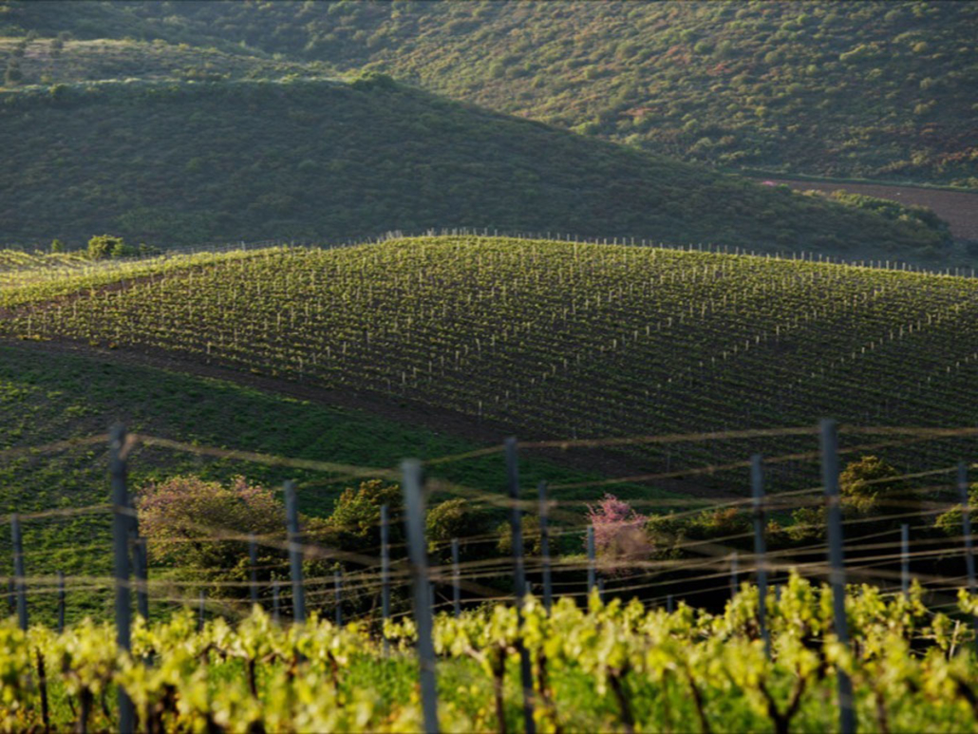
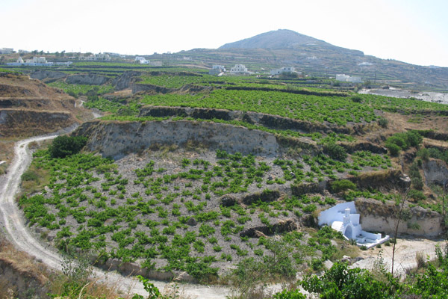
Notes:
Greece is at the same time one of the most ancient winemaking cultures and yet is considered one of the newer emerging winemaking countries in the market.
Thousands of years wine making tradition with many great stories to tell
First culture of wine in the world
Authenticity and Originality: 300+ indigenous grapes, amazing microclimates
Boutique style winemaking: Valuable and rare finds
Wine tourism amongst many breathtaking winemaking regions

Slide 13
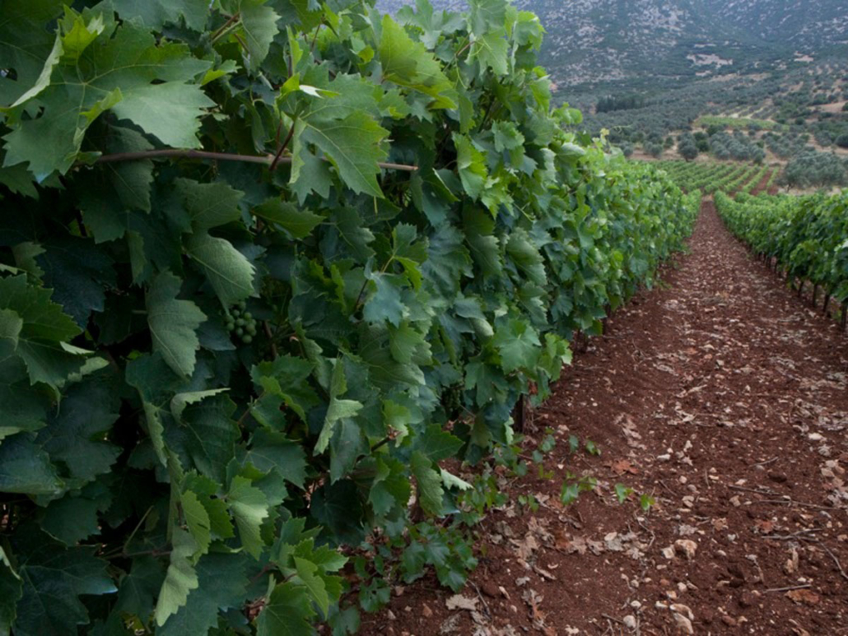
Notes:
Dramatically diverse landscape
Food friendly wines
Great value especially, for medium and premium categories
Talented, educated winemakers

Slide 14
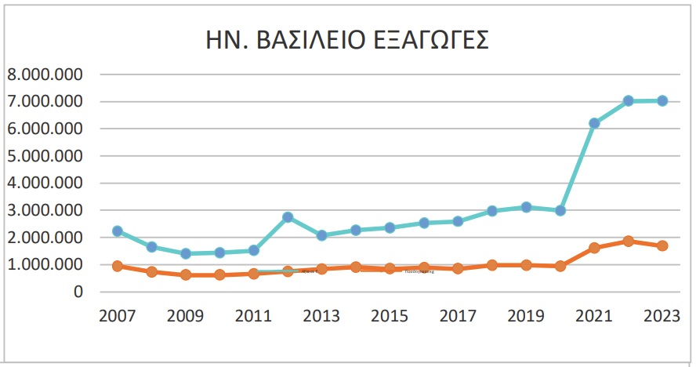
Greek wine exports to the UK
Exports to the UK
Value in €
Quantity in kg
Price/Quantity € / kg
2018 | 2019 | 2020 | 2021 | 2022 | 2023 | % | 5 Years Average
2.966.807 | 3.116.931 | 2.993.638 | 6.197.261 | 7.012.441 | 7.017.702 | 0,08 | 4.457.416
974.917 | 975.875 | 939.520 | 1.616.371 | 1.857.776 | 1.690.213 | -9,02 | 1.272.892
3,04 | 3,19 | 3,19 | 3,83 | 3,77 | 4,15 | 10,00 | 3,00
%
57,441
32,79
21,89

Slide 15
1. TSIMBIDI KYDONITSA 2023
Grape11 | Kydonitsa
Denomination | PGI Laconia
Viticulture | Organic
Soil | Alcalic Limestone, loamy soils and rarely more acidic. Poor in organic matter, no calcium carbonate
Altitude | 250-300m
Vineyard age | 18-20 years
Vinification | White vinification in stainless-steel tank, fermentation at controlled temperature of up to 64.4 ° F/18 ° C and maturation for five months over fine lees with regular stirring.
Alcohol % | 13
pH 3.28 | Acidity: 5.7 g/l tartaric
Total production | 40-45.000 bottles

Slide 16
Peloponnese
Notes:
in the Middle Ages Malvasia wine was exported to the entire then known world from the port of Monemvassia
The southern-most tip of the Balkan Peninsula.

Slide 17
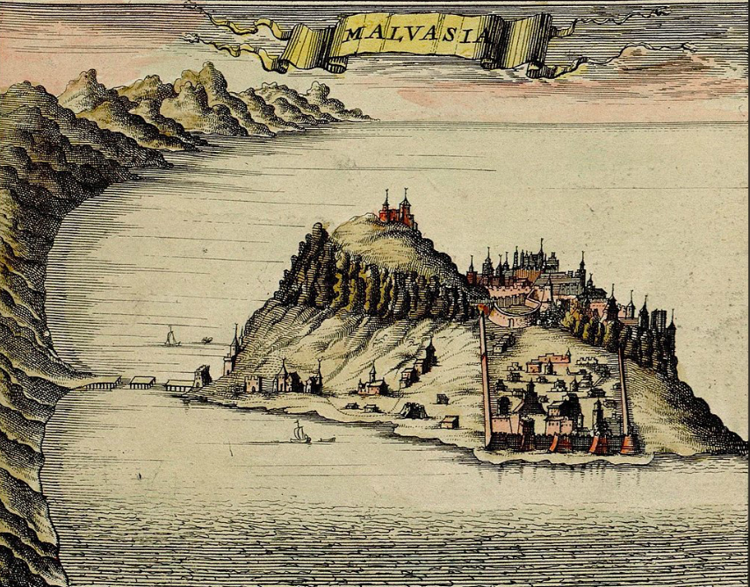
Laconia
PDO Monemvasia – Malvasia
The wines of Monemvasia-Malvasia were famous throughout the Mediterranean since the Byzantine Era (12th century). Recently the appellation Monemvasia-Malvasia was recognized in European level and is amongst the latest PDO wines of Greece.
Sweet wines
At least 51% Monemvasia with Assyrtiko, Asproudes, Kydonitsa
Established in 2010
2 years of oxidative ageing
Same vintage or blend with the latest on the label
Notes:
Laconia has not managed to develop as much as the others, despite being one of the most important viticultural regions of Greece in the Middle Ages
The number of varieties cultivated in the region is impressively large

Slide 18
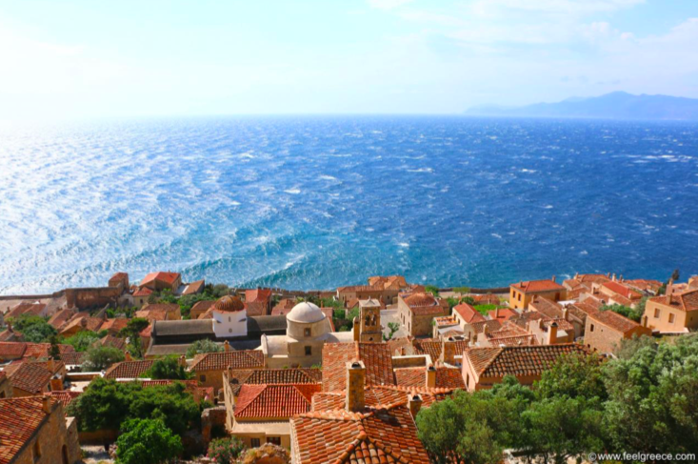
KYDONITSA
From Laconia (south-eastern Peloponnese)
Almost extinct white grape, emerging in the last 15 years,
Dry wines as single variety or in blends
Part of the blend in sweet PDO Monemvasia-Malvasia
Medium body, lemony, green color, intense aromas, dominated by notes of ripe quince -Kydoni in Greek- On the palate it is round, soft, and textured.
To be consumed fresh or with 3-5 years of aging

Slide 19
2. KTIMA SPIROPOULOS MANTINIA 2023
Grape11 | Moschofilero
Denomination | PDO Mantinia
Viticulture | Organic
Soil | Silt clay
Altitude | 650-680m
Vineyard age | 20 years
Vinification | Cold maceration for few hours, classic white vilification at low temperatures
Alcohol % | 12%
pH: 3.3 | Acidity: 6.52 g/lt
Total production | 8000

Slide 20
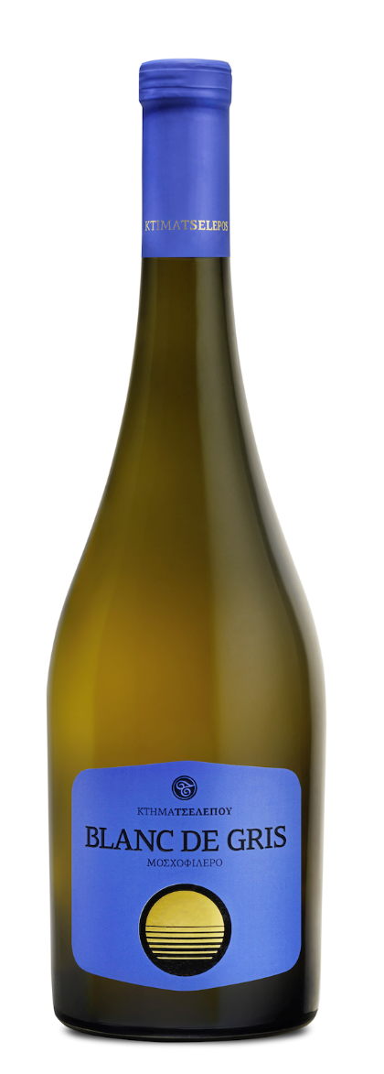
3. TSELEPOS WINES BLANC DE GRIS 2023
Grape11 | Moschofilero
Denomination | PGI Arcadia
Viticulture | Organic
Soil | Mountainous/ clay rocky soil
Altitude | 750m
Vineyard age | 25 years old
Vinification | Modern vinification techniques, trying to bring out the delicate aromas of the variety, with the use of pre-fermentation extraction at 10°C for a few hours and at a percentage of 100%. Part of the wine is fermented in stainless steel tanks, another part in amphoras and the rest in large oak barrels, "foudres", where the fermentation is concluded. The wine remains in the containers and matures on it’s fine lees, for 4 months.
Alcohol % | 12.5
pH: 3.10 | Acidity: 5.5 g/lt

Slide 21
Peloponnese
Notes:
in the Middle Ages Malvasia wine was exported to the entire then known world from the port of Monemvassia
The southern-most tip of the Balkan Peninsula.

Slide 22
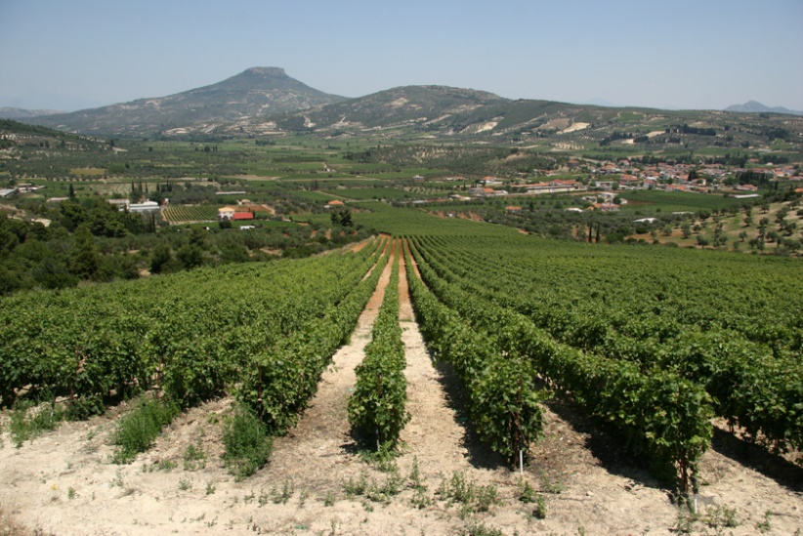
PDO Mantinia
North of Tripoli
600m + altitude
Dry climate
85% of the vineyards is Moschofilero and the rest Asproudes
Late harvest (even November)
Dry whites
Sparkling brut nature, extra brut, brut, extra sec, sec, demi sec, doux
Notes:
Located in the heart of the Peloponnese
One of the first regions where organic cultivation was practised
Glikerithra, the best of the Asproudes family, is often mixed with Moschofilero because of its high sugar content and low acidity

Slide 23
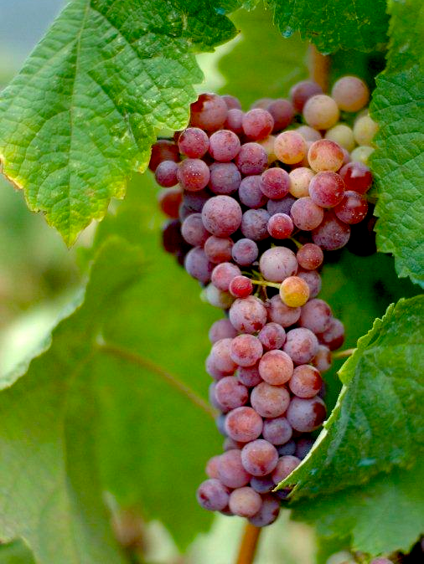
MOSCHOFILERO
Pink skinned variety
Resistant to draught
Late ripening variety
High yields
White, rose, Gris de Noir
Still and sparkling
Mainly in Peloponnese
High acidity
Aromas of roses, citrus flowers, grapefruit, lime
Light to medium body
Blends with Roditis and Savatiano
Notes:
Off-white tone, usually referred to as the ‘grey’ variety
Though Moschofilero shares a few characteristics with Muscat and Gewurztraminer, botanically speaking has no affiliation to any to them
Mavrofilero (black), Xanthofilero (blond) and Asprofilero (white) are sub-clones, while the most impressive results come from Mavrofilero
Dry white ones, gris de noir, light roses, sparkling wines produced either with the Charmat method or with the traditional method

Slide 24
4. GREEK WINE CELLARS ASSYRTIKO 2023
Grape11 | Assyrtiko
Denomination | PGI Peloponnese
Viticulture | Conventional
Soil
Altitude
Vineyard age
Vinification
Alcohol % | 12.5
pH | Acidity:

Slide 25
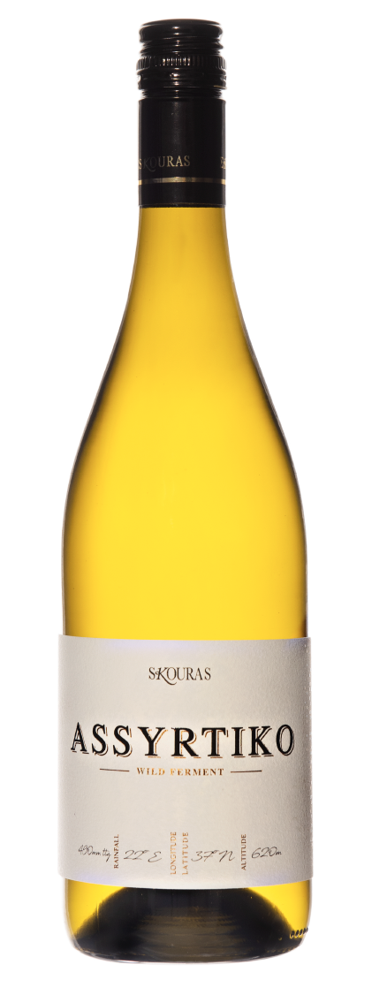
5. DOMAINE SKOURAS ASSYRTIKO WILD FERMENT
Grape11 | Assyrtiko
Denomination | PGI Peloponnese
Viticulture | Conventional
Soil | Red clay
Altitude | 620m
Vineyard age | 10 years old
Vinification | Whole Bunch press, stainless steel fermentation at 15 oC, sur lie for 4 months. No malolactic fermentation.
Alcohol % | 14%
pH 3.25 | Acidity: 6.5g/lt

Slide 26
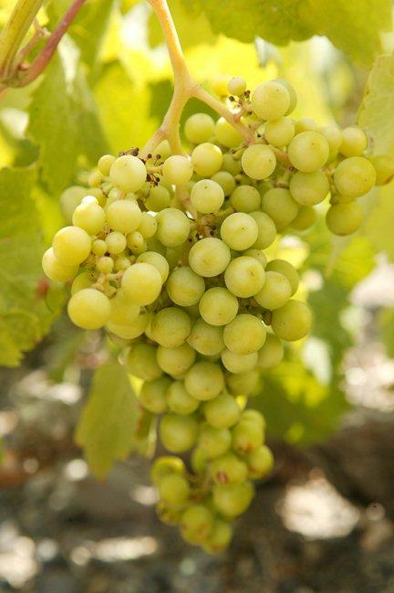
ASSYRTIKO
One of the noblest white varieties of the world
High adaptability
Resistant to most diseases
High levels of acidity
Not particularly high aroma intensity
Purity
Medium to full body
High alcohol
Long ageing potential
Best offer for climate change
Notes:
Its vigour is medium to high and under suitable conditions it can produce high yields

Slide 27
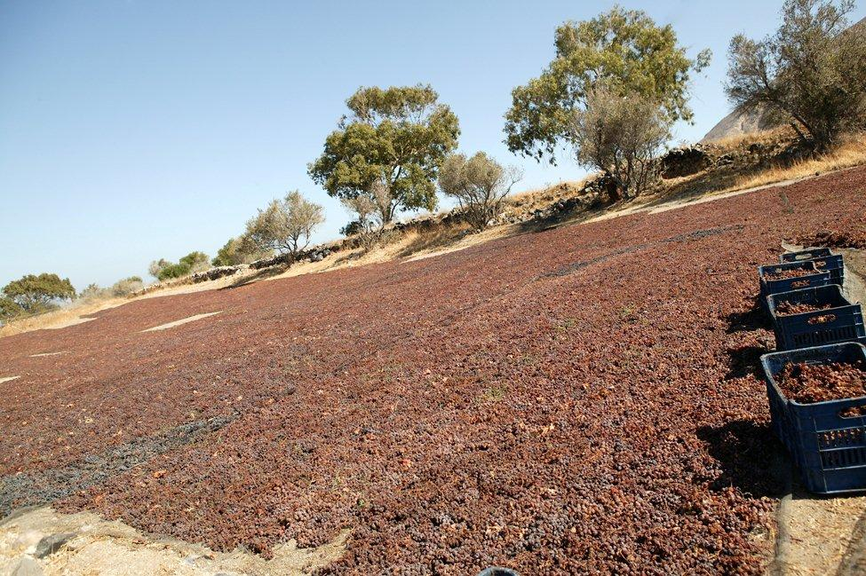
Assyrtiko
Green apple & white peach
Crushed seashells and stone
Minerality
When fermented or aged
in barrels:
Ripe stone fruits
Honey & wax
Petrol & flint
Notes:
Colour: medium intensity
Acidity: high
Aromas: not of high intensity but highly individual
Green apple, peach, crushed seashells and minerals
Maturity in bottle: honey, kerosene - high ageing potential
Unoaked Style: austere, dry, mineral
Oaked Style: rich, full, complex

Slide 28
6. ESTATE MEGA SPILEO WHITE 2019
Grape11 | Assyrtiko 75% Lagorthi 25%
Denomination | PGI Achaia
Viticulture | Organic
Soil | Clay & Sand
Altitude | 850m
Vineyard age | 15-20 years
Vinification | After harvesting, the grapes are pressed and undergo pre-fermentative extraction for roughly 4 hours. This is followed by static racking. The grape must is then fermented and aged in new oak barrels of varying sizes, and matures with its wine lees for 6 to 7 months. The settled lees are periodically re-stirred into the wine (bâtonnage). After bottling, the wine must remain in it’s bottle for at least 2 years to develop character.
Alcohol % | 12.5
pH: 3.24 | Acidity: 5.5g/lt

Slide 29
7. GAIA AGIORGITIKO BY GAIA 2022
Grape11 | Agiorgitiko
Denomination | PDO Nemea
Viticulture | Organic
Soil | It consists of a shallow (70-80cm) clay layer that lies upon the lime mother soil with relatively neutral pH. Low organic content, like most of the limestone soils in Greece. On the slopes of the hills where most of the vineyards are located, the soils drain quite well but are exposed to erosion.
Altitude | 500-550 m
Vineyard age | 10-20 years
Vinification | Extraction at 22-26°C for approx. 10 days in stainless steel fermententors. Cold stabilization. No animal products or allergens have been used. Aged 12 months in second use French oak casks
Alcohol | 14%
pH: 3.64 | Acidity: 5.98 g/lt

Slide 30
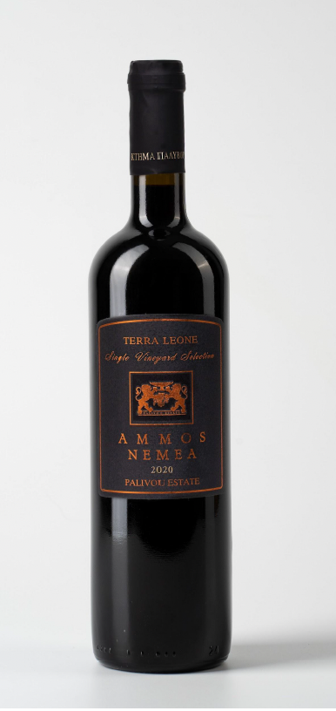
8. PALIVOU AMMOS TERRA LEONE 2021
Grape11 | Agiorgitiko
Denomination | PDO Nemea
Viticulture | Organic
Soil | Limestone and sandy soil
Altitude | 470m
Vineyard age
Vinification | 5 days cold maceration, traditional red vinification at gradual increased temperatures Fermentation at stainless steel tanks. Aged 14 months, 70% aged in new french oak barrels 225 LT & 500LT 30% aged in Clay amphorae 400 LT & 600 LT
Alcohol % | 15
pH | Acidity: Acidity: 6g/lt

Slide 31
Peloponnese
Notes:
in the Middle Ages Malvasia wine was exported to the entire then known world from the port of Monemvassia
The southern-most tip of the Balkan Peninsula.

Slide 32
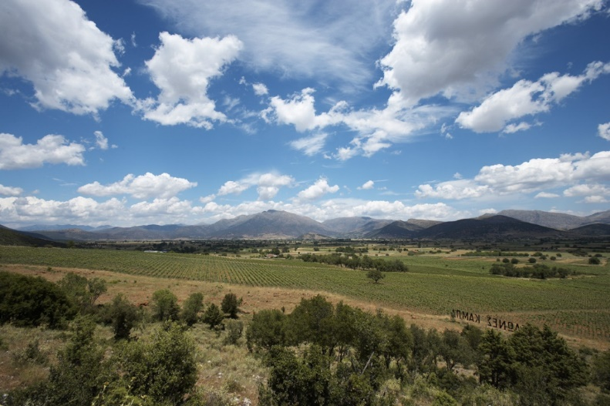
Korinthos/Argolida
Mild winters, warm summers
Late harvest at high altitudes
Rainfall during the harvest
PDO Nemea
Notes:
Mild winters, very hot summers and temperatures that often exceed 40°C (104°F)
Huge differences in quality, from high-quality PDO red wine from Nemea to mass production of cheap wine, mainly of the Roditis variety
The name of Agiorgitiko comes from Agios Georgios (St. George), the village after which Nemea was known during Ottoman Rule

Slide 33
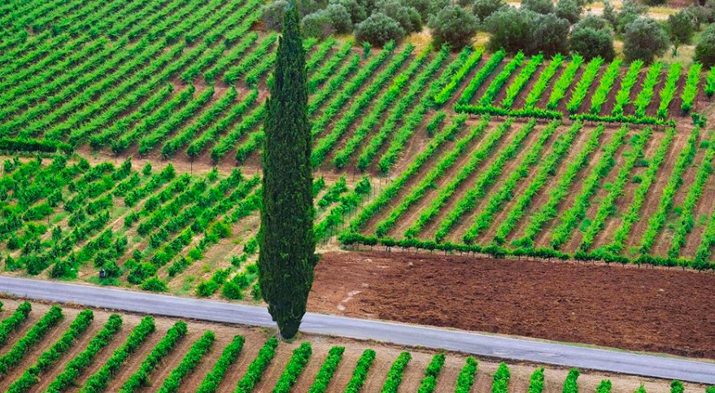
PDO Nemea
26 villages
3 zones depending on altitude
1st zone
230- 450 m
Higher temperatures
Red clay
Light wines & Vin de liqueur

Slide 34
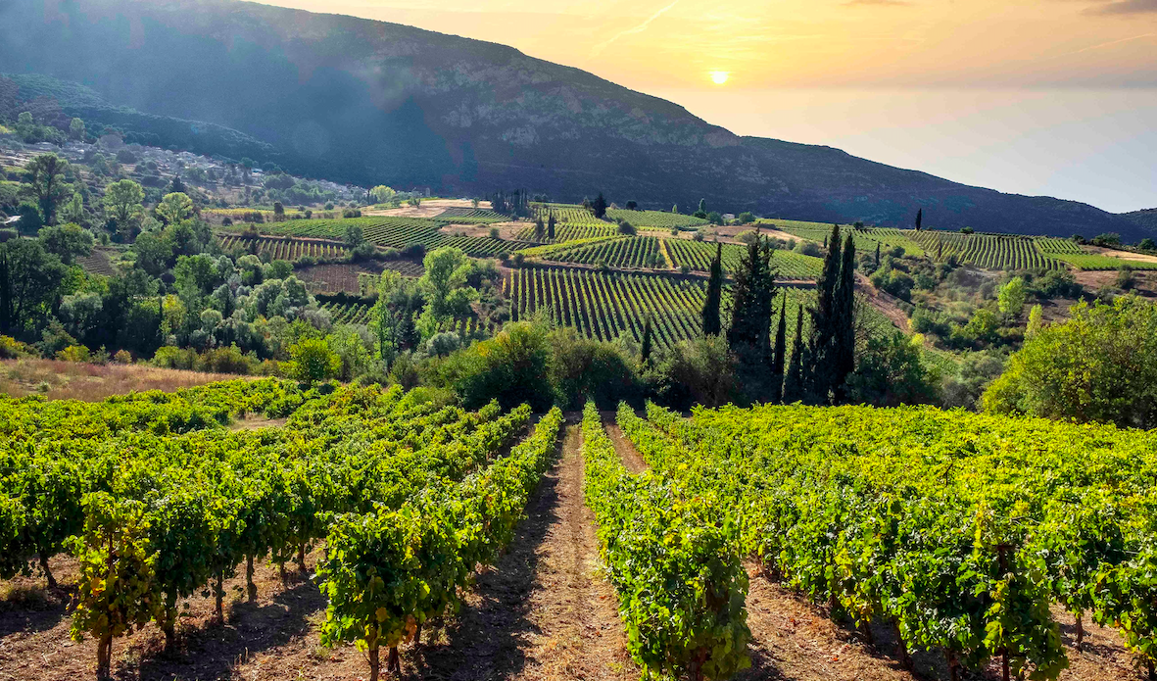
PDO Nemea
2nd Zone
450 – 650 m
Cooler than the 1st zone
Less water
Variety of soils
Lower yields
More extract and greater ageing potential

Slide 35
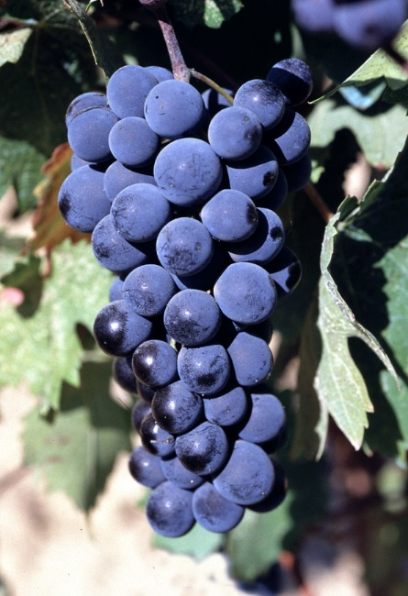
PDO Nemea
Red, dry, medium dry, sweet
Agiorgitiko 100%
Deep, bright color
Sweet red fruits and sweet spices
Medium to full body
Soft tannins
Notes:
Generally, a dry Agiorgitiko from Nemea has a deep and intense colour, sweet aromas of fresh, ripe forest fruits and spices, relatively high acidity, and medium to full body with noticeable yet soft tannins
The sweet wines can be produced from sun-dried grapes (naturally sweet) or by fortification with alcohol (natural sweet)

Slide 36
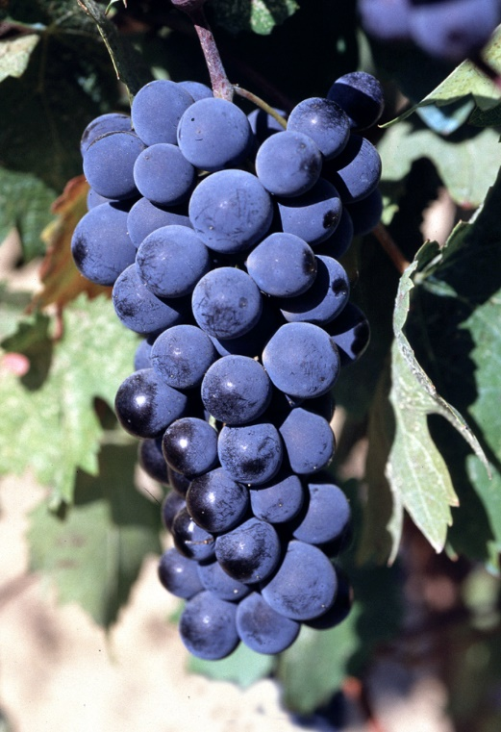
AGIORGITIKO
Productive variety
Sensitive to diseases and draught
Late ripening
Versatile
Rose, light reds, medium bodied, rich tannic with ageing potential wines
Peloponnese
© Wines of Greece
Notes:
Considered the most commercial and the most widely recognised Greek red variety on the international market
Can be particularly high-yielding

Slide 37
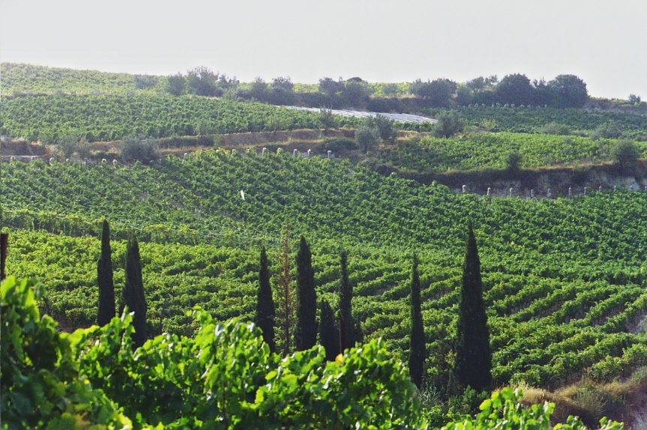
AGIORGITIKO
Deep color
Sweet red fruits, sweet spices, chocolate
Medium to high acidity
PDO Nemea
Often blended with Cabernet Sauvignon
© Wines of Greece
Notes:
Colour: deep
Acidity: high
Tannins: medium-soft
Aromas: red fruits, cherry, raspberry, sweet spices,
coffee, chocolate
Bottle ageing: develops fast, coffee, chocolate
Wine style: fruity, dense, rich

Slide 38
9. MUSES ESTATE MOUHTARO 2022
Grape11 | Mouhtaro
Denomination | PDO Mantinia
Viticulture | Organic
Soil | Sandy loam to clay loam
Altitude | 450-550m
Vineyard age
Vinification | Grapes are destemmed and left on skins in low temperature for four days (cold soak). Must is fermented for twenty days and wine continues maceration for another ten days.
Alcohol % | 13
pH | Acidity:

Slide 39
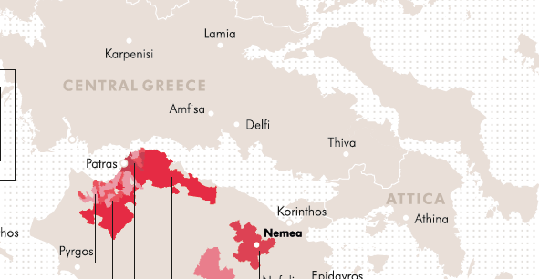
Central Greece
Part of the Pindos Mountain Range
Wide diversity of soils / from very poor to very fertile
Complex topography
Attiki
Evia
Viotia
Fthiotida

Slide 40
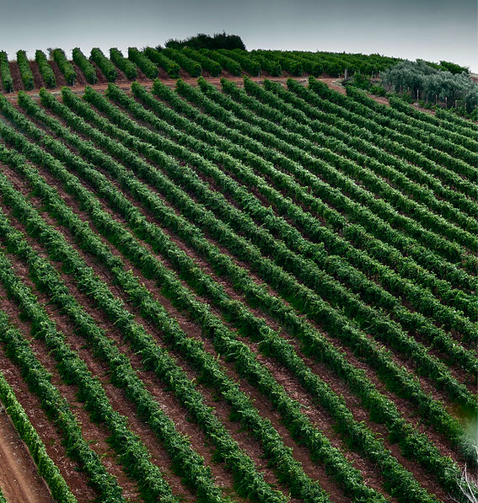
Muses valley
North-west of Athens, in the region of Viotia
On the slopes of Mount Helicon
Climate: mild, with wet winters and dry summers. Long periods of sunshine
Altitude between 450 and 520 m with a slope between 5 and 10%.
Linear vines with a North to South orientation
Cold air currents coming down from Mount Helicon
The soil is fertile, with mixed composition ranging from sandy loam to clay loam.
More than 50 hectares of cultivated vineyards
​

Slide 41
MOUHTARO
Rare, up and coming variety Color: Dark black red. Aromas: Sour cherry, blueberries, herbal notes of mint, floral notes of violet and lavender. Acidity: Crisp Taste: Rich, creamy, layered, and dense with long aftertaste. Body: Full

Slide 42
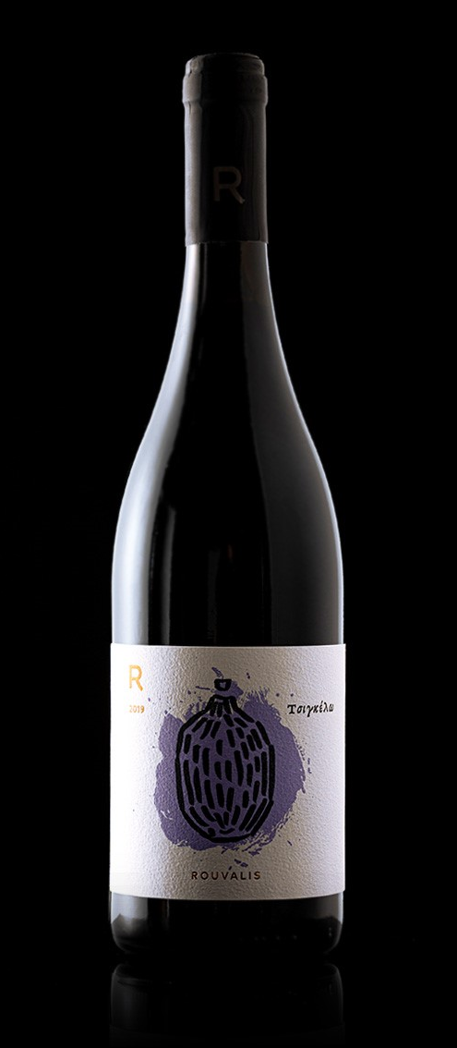
10. ROUVALIS TSIGELLO 2022
Grape11 | Mavrodaphne
Denomination | PGI Slopes of Aigialeia
Viticulture | Organic
Soil | poor, well-draining soils
Altitude | 500 – 650m
Vineyard age
Vinification | cold maceration at 8–10°C for 3 days, fermentation at 15-20°C. Aged 80% in handmade clay amphorae and 15% in old French oak barrels for about five months. Bottled unfiltered.
Alcohol % | 13
pH: 3.8 | Acidity: 5.7g/lt

Slide 43
11. PARPAROUSSIS TAOS 2020
Grape11 | Mavrodaphne
Denomination | PGI Achaia
Viticulture | Organic
Soil | Gravel-sand, alluvial deposits
Altitude | Sea level
Vineyard age | 30 years
Vinification | 25 days of extraction, UNFILTERED
Alcohol % | 14
pH: 4 | Acidity: 4.8g/lt

Slide 44
12. CLAUSS MTR 2020
Grape11 | Mavrodaphne
Denomination | PGI Achaia
Viticulture | Organic
Soil | Sandy clay
Altitude | 350m
Vineyard age | 55 years
Vinification | Appasimento method for 2 days in specially designed construction. Fermentative extraction at low temperature, vinification in wooden fermentors with mild pigeage the grape puree manually and gentle manual pressure on wooden press. Aging 14 months in French oak 225lt second-use barrels.
Alcohol % | 16
pH: 3.58 | Acidity: 6.3 g/lt
Production | 1000 bottles

Slide 45
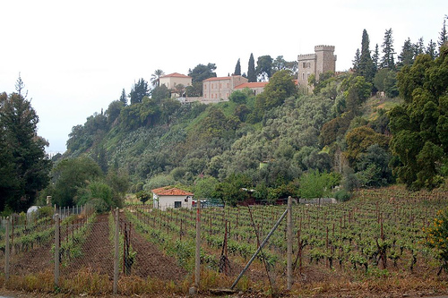
MAVRODAPHNE
Ionian Islands & Peloponnese
Vigorous growth
Sensitive to diseases and draught
Late ripening variety
Dry and sweet wines
Deep color
High level of tannins
© Wines of Greece
Notes:
Mavrodaphne is one of the most famous Greek wines abroad, for it has long been the favourite wine of tourists visiting Greece on holiday
More famous for the sweet styles but dry styles are emerging and can be excellent

Slide 46
MAVRODAPHNE
Ripe aromas of sweet fruits, cherry, plum, spices, daphne (laurel)
Port Style wines
Oxidative long ageing: coffee, chocolate, caramel
Blends with Mavri Korinthiaki
Blends with Refosco, Cabernet Sauvignon
PDO Mavrodaphne of Patras
PDO Mavrodaphne of Cephalonia
© Wines of Greece
Notes:
prolonged oxidative ageing in oak barrels, through which the wines acquire aromas of spices, herbs, coffee, chocolate and caramelised sugar
Aged Mavrodaphne can be impressively complex
Colour: deep
Acidity: medium
Tannins: medium to high
Aromas: cherry, dried plum, spices, bay leaf
Bottle ageing: chocolate, coffee, dried fig, sugar caramel, fruitcake
Wine style: mainly sweet, dry, complex
MAVRODAPHNE OF PATRAS: Mavrodaphne 51%, Mavri Korinthiaki

Slide 47
13. AVANTIS MAVROKOUNDOURA 2019
Grape11 | Mavrokoundoura
Denomination | PGI Evia
Viticulture | Conventional
Soil | Clay, sandy clay
Altitude | 350m
Vineyard age
Vinification | Classic red wine vinification. Alcoholic fermentation and extraction for 25 days. Barrel ageing for 12 months in French oak barrels (225lt) Bottled unfiltered.
Alcohol % | 14.1
pH 3.64 | Acidity: 5g/lt

Slide 48
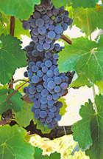
MAVROKOUNDOURA (MANDELARIA)
Originates from the Aegean sea, Cyclades, Rhodes and Crete, and from there to rest of Greece
A thick skin grape, very rich in anthocyans and antioxydants
It was used for many decades to strengthen the color of light reds in Greece and in France when phylloxera destroyed the French vineyard
Late ripening wines with lower alcohol and acidity
Vigorous and productive
Prone to downy mildew
Ripens mid September
Low clonal diversity with 2 biotypes under research

Slide 49
14. ANTONOPOULOS VERTZAMI 2019
Grape11 | Vertzami
Denomination | Varietal wine
Viticulture | Conventional (island of Lefkada)
Soil | Sandy clay
Altitude | 600 m
Vineyard age | 50 years
Vinification | Cold soak for 24 hours, long extraction. Aging for 19months in 2nd and 3rd use of 225lt oak barrels
Alcohol % | 12.5
pH: 3.3 | Acidity: 6.8 g/lt
Production | 3000 bottles

Slide 50
Vertzami
Rare red grape of Italian origin. A rising star
Introduced in Lefkada during Venetian occupation 14-17 centuries AD
Now also cultivated in the Peloponnese, Central Greece and some in Epirus
High phenolic potential (one of the highest in Greece), deep red colour, high acidity and great structure
Very interesting aroma of black fruits, eucalyptus and cedar
Late ripening
Produces wines with dark red colour and often used to strengthen colour of other red wines

Slide 51
15. PAPAGIANNAKOS RETSINA
Grape11 | Savatiano
Denomination | PGI Retsina Appellation by tradition Mesogea
Viticulture | Conventional
Soil | Limestone
Altitude
Vineyard age | 60 years
Vinification | Fermentation in stainless steel vats under controlled temperature, during which pine resin from selected pine trees of Attica is infused in the wine
Alcohol % | 12.5
pH: 3.45 | Acidity: 5.75g/lt

Slide 52
RETSINA
In antiquity pine resin added as a natural antioxidant
Amphorae were sealed with Pine resin as a natural preservative to protect the wines during long voyages.
Resin also added a flavoring to the wine and people became accustomed to. ►The first Retsinas were created.
Retsina popular in the 1960s when Greece emerged as a global tourist destination.
Retsina, connected with the Greek summer, taverns by the sea, the warm sun and fresh seafood

Slide 53
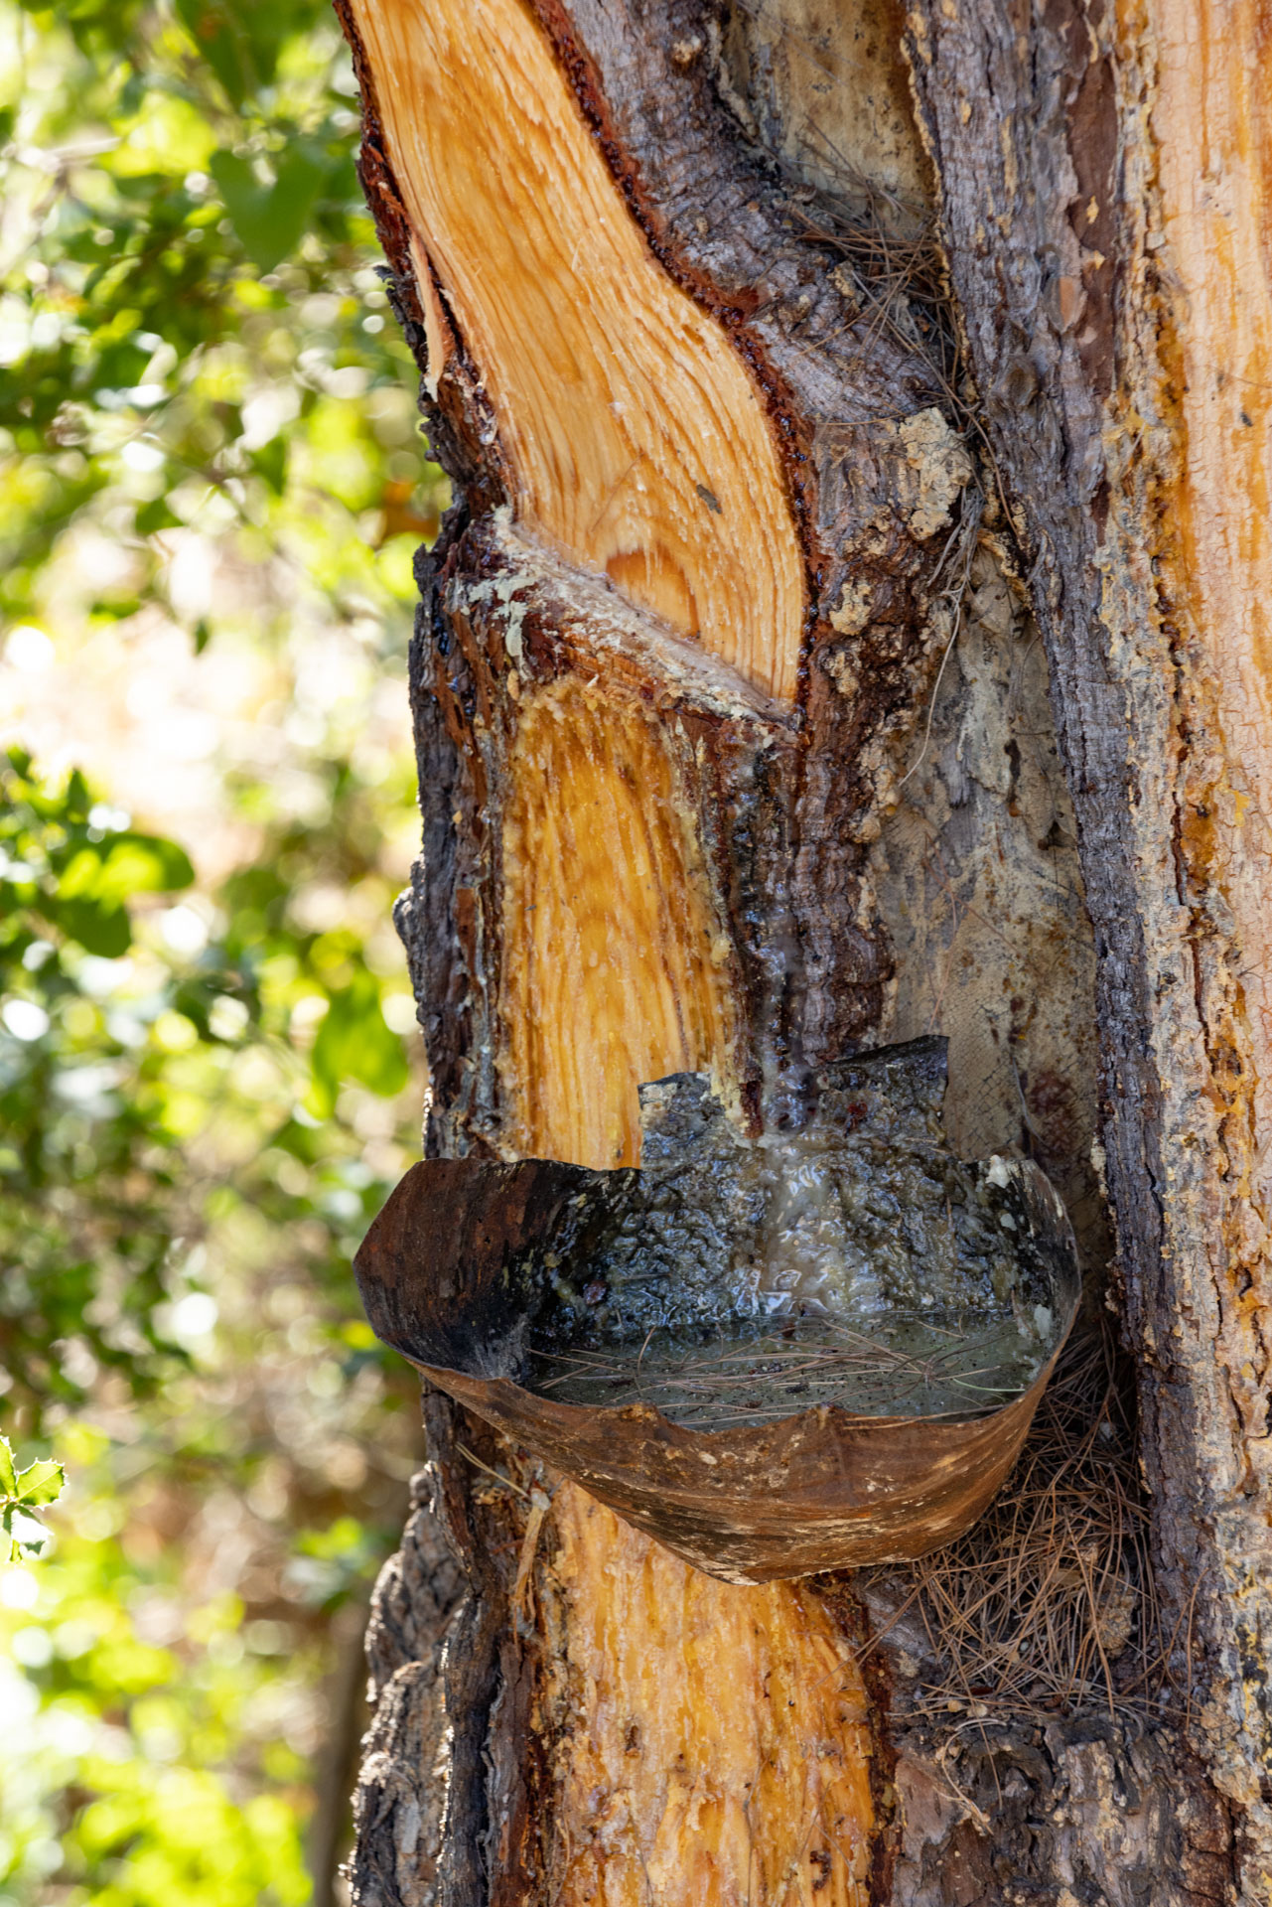
RETSINA
Retsina was the most recognizable wines Greece, but this did not mean quality
Always the cheapest wine on the table, usually made from inferior wine.
The name Retsina became associated with cheap, poor quality wines.
Usual practice at the time was:
use large doses of resin to mask poor quality grapes
often by untrained, amateur winemakers without advanced technical means.
Wines turned out to be oxidized, flabby, without any freshness and lacking in balance. The over use of resin also destroyed any hint of the grape.

Slide 54
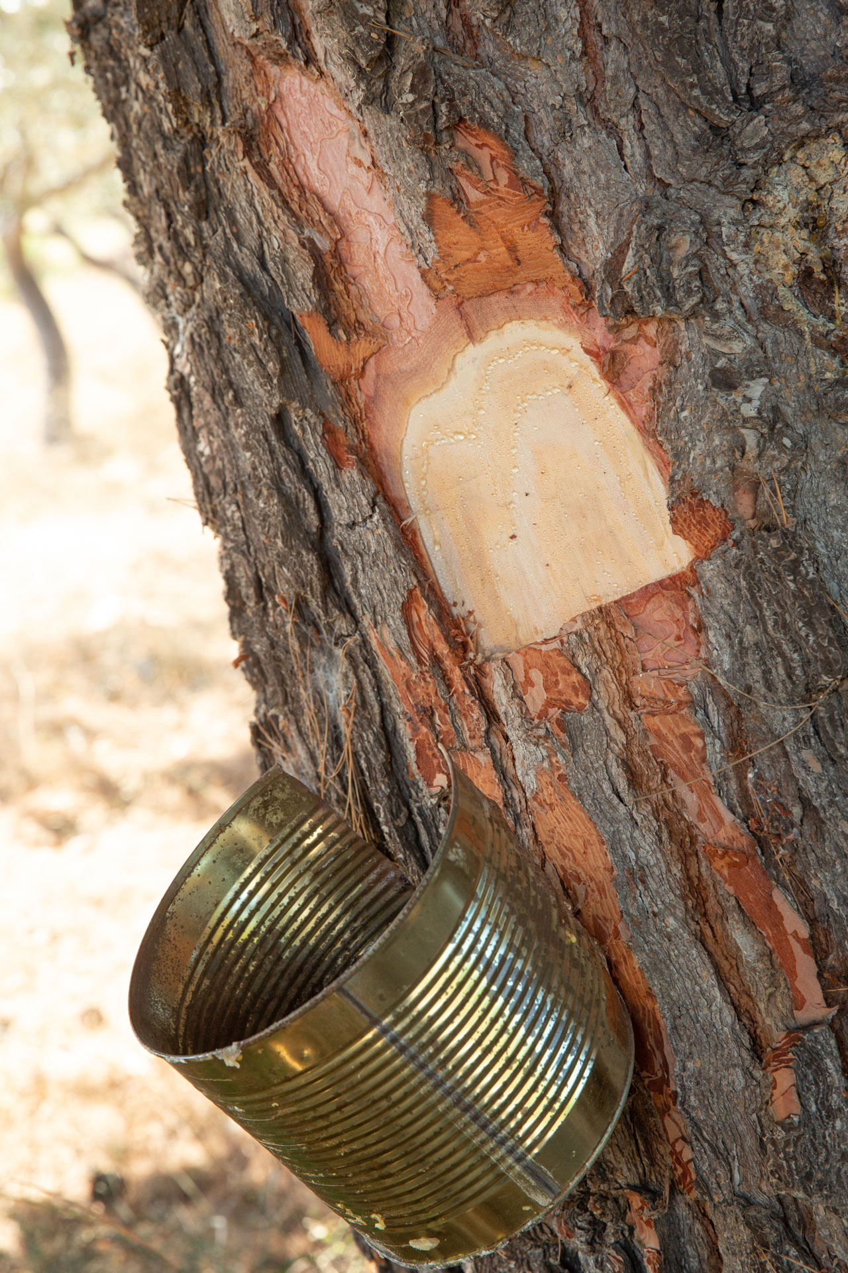
TODAY’S RETSINA
Top grape quality
State of the art winemaking technology, use of modern amphorae and oak barrel aging.
Aleppo pine resin (PINUS HALEPENSIS) added before the start of the alcoholic fermentation (or during as long as no amount of sugar greater than 1/3 of the original content has been fermented), in an amount of up to 1 kilogram per 100 liters of must.
Often producers use a significantly lower percentage of pine resin.
In addition to the amount of resin, the amount of time the resin is with the must is carefully controlled, as well as the temperature at which the extraction takes place.
Modern Retsinas show elegant aromas of pine, sage, rosemary, mastic, ginger and spicy spices accompany the dense fruit
The best Retsinas now show aging potential

